Slide 1
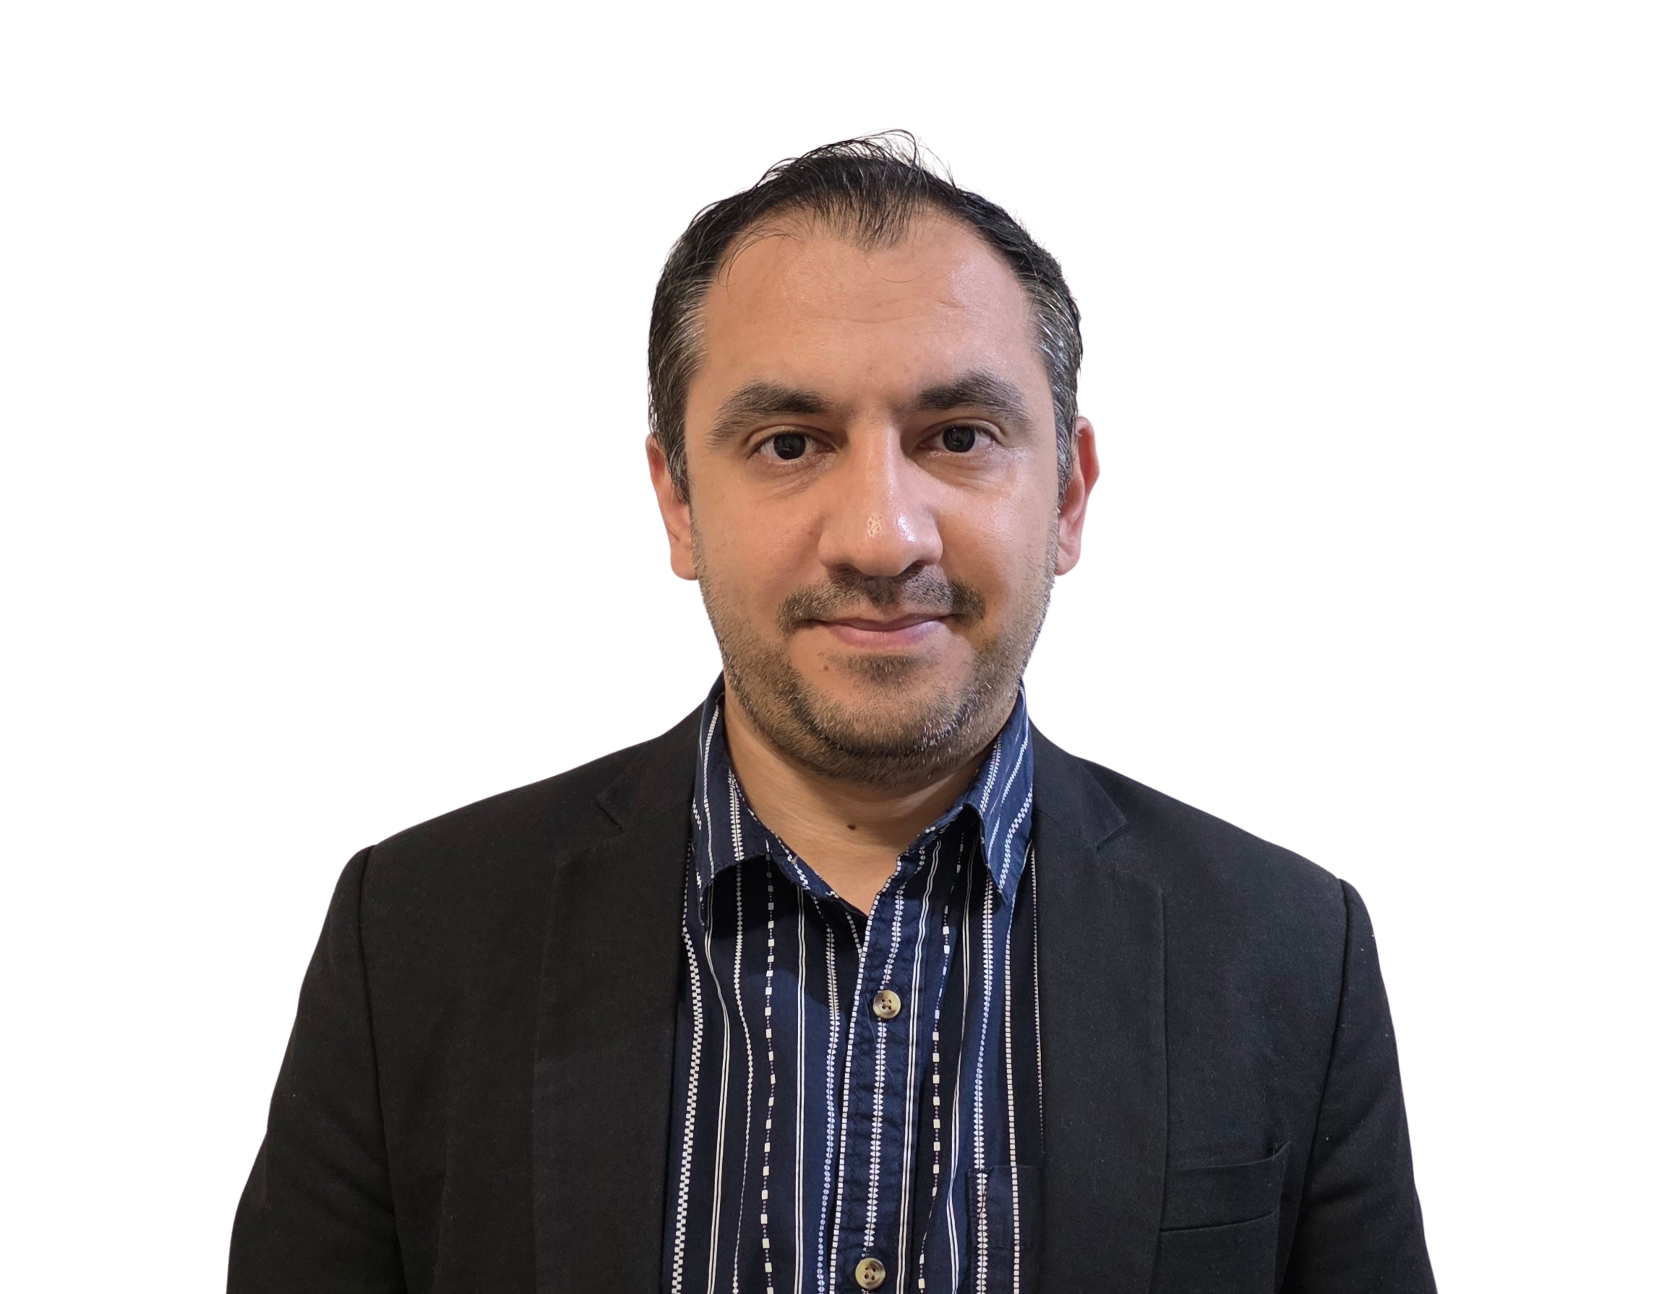
32555 – Fundamentals of Software Development

Slide 2
Welcome to 32555 – Fundamentals of Software Development
Your Teaching Team:
Dr. Yining Hu | Subject Coordinator
Yining is a Lecturer in Software Engineering. She works with many SMEs to develop software and AI solutions through student and research projects at UTS.
Contact: yining.hu@uts.edu.au
Dr. Xiaojie (Zoe) Lin | Tutor
Zoe is a full-stack software engineer with an interest in data analysis, specializing in JAVA, R, Python, JavaScript, PHP, Bash, and MATLAB; familiar with AWS.
Contact: Xiaojie.Lin@uts.edu.au
Dr. Farshid Keivanian | Tutor
Dr. Farshid Keivanian is an experienced university lecturer and researcher with a PhD in Information Technology. He has over 15 years of teaching experience across Australian institutions, specialising in software engineering, data science, AI, and cybersecurity.
Contact: Farshid.Keivanian@uts.edu.au
Yong Pov | Tutor
Yong is a full-stack software engineer with experience in React, JavaScript, TypeScript, Java, Python, SQL, and AI-assisted learning platforms.
Contact: Yong.Pov@uts.edu.au

Slide 3
Welcome to 32555 – Fundamentals of Software Development
Cmp1 # | Location | Time | Tutor
01 | CB11.B1.400 | Fri 16:00-18:00 | Xiaojie (Zoe) Lin
07 | CB11.B1.401 | Wed 10:00-12:00 | Farshid Keivanian
08 | CB11.B1.400 | Fri 12:00-14:00 | Yong Pov
09 | CB11.B1.103 | Wed 16:00-18:00 | Farshid Keivanian
10 | CB11.B1.401 | Wed 12:00-14:00 | Farshid Keivanian

Slide 4
Week 6 Outline
Assessment 1 Part 1 – Clarifications and Quality Check
Have you formed your group?
Lab 6 Exercises
Example & Activity — Campus Parking Permit System
Group Assignment – Part 1: What to do / submit / avoid
Group Assignment – Part 1: Student Operations After Registration – Clarified
Group Assignment – Part 1: Password Rules – Clarified
Mini Coding Nudges (Email/Password, Marks, Pass/Fail etc.)
Allow student. subdomain too
Allow optional - or _ before digits in password
Generate Random Marks and Assign Grades
Make randomness reproducible
Add student ID and PASS/FAIL
Grade Classification Based on University Rules
Group Assignment – Part 2: Build hints (Python-first, JavaFX minority)
Group Assignment – Part 3: Showcase tips
Example & Activity — Event Ticketing Lite
Reference Note for Students

Slide 5
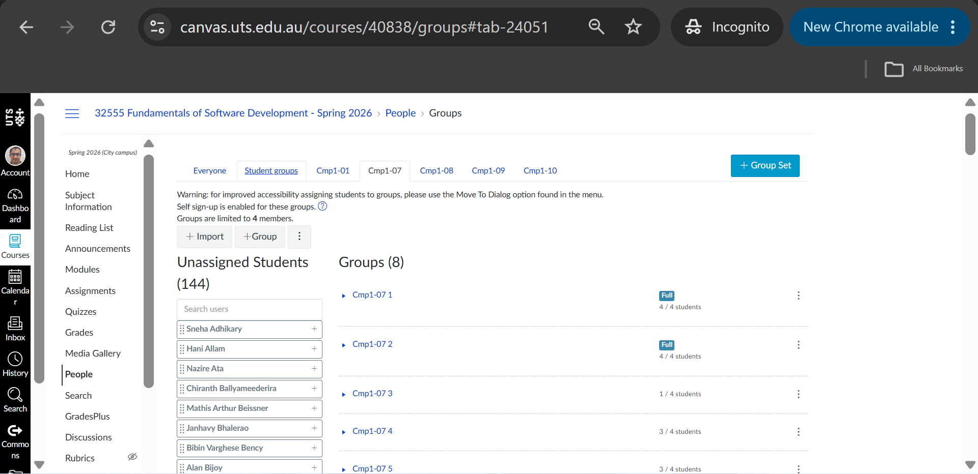
Have you formed your group?

Slide 6
Assessment 1 Part 1 – Clarifications and Quality Check
1. Backlog User vs UML Actor
Question
Can System appear in the User column of the backlog?
Yes, where appropriate.
The backlog defines the User as the person or entity taking the action.
For example, if the application automatically performs a validation or generates something, the entity performing that action may be the System.

Slide 7
Assessment 1 Part 1 – Clarifications and Quality Check
Question
Does that mean System should also be an actor in the Use Case Diagram?
No.
For this project, the external UML actors are:
Student Admin
The application itself is shown using the system boundary.
Remember Backlog “User” ≠ always UML “Actor”.
This is an important difference between the two modelling activities.

Slide 8
Assessment 1 Part 1 – Clarifications and Quality Check
2. Start Every Decision from the Requirement
Before adding something to your backlog or UML diagram, ask:
Where does this come from in the project brief?
If you cannot connect it to a requirement, ask whether it is really necessary.
Example
Requirement:
A student can enrol in a maximum of four subjects.

Slide 9
Assessment 1 Part 1 – Clarifications and Quality Check
From this we can identify:
User goal: Enrol in a subject Rule: Maximum four subjects System behaviour: Check whether another subject can be added Possible error: Inform the student if the limit has been reached
Why?
We are converting requirements into design rather than inventing new requirements.

Slide 10
Assessment 1 Part 1 – Clarifications and Quality Check
3. Do Not Turn Every Internal Step into a Use Case
Question
Should every validation, calculation, file read and variable update become its own use case?
No.
Use cases should mainly describe meaningful behaviour from the user's point of view.

Slide 11
Assessment 1 Part 1 – Clarifications and Quality Check
Some supporting behaviour may be represented using <<include>> when this makes the diagram clearer, but avoid making the diagram look like program code.
Example
Enrol in Subject
is a meaningful Student goal.
Checking the number of subjects is a rule required to complete that goal.
You may model an important reusable check separately, but you do not need an oval for every internal programming statement.

Slide 12
Assessment 1 Part 1 – Clarifications and Quality Check
Skill
This teaches you to separate: requirements modelling
From implementation detail.

Slide 13
Assessment 1 Part 1 – Clarifications and Quality Check
4. When Should I Use <<include>>?
Ask) Does this behaviour have to happen as part of the main use case?
If yes, <<include>> may be appropriate.
Example) Registration requires valid registration details.
If you model Validate Registration Details separately:
Register <<include>> Validate Registration Details
Remember) <<include>> = required/reused behaviour
The arrow points toward the included use case.

Slide 14
Assessment 1 Part 1 – Clarifications and Quality Check
5. When Should I Use <<extend>>?
Ask: Does this behaviour happen only under a condition?
If yes, <<extend>> may be appropriate.
Example) An authentication error occurs only when authentication fails.
It does not occur during every successful login.
Remember) <<extend>> = conditional/optional additional behaviour
Do not use <<extend>> simply because the tool exists.

Slide 15
Assessment 1 Part 1 – Clarifications and Quality Check
6. Student and Admin Responsibilities
Ask yourself) Who initiates this action according to the requirement?
A Student performs Student-related goals.
An Admin performs student-management goals.
Do not assign an automatic system action to Admin simply because Admin has management access.
Example) If the system automatically calculates a grade from a mark, that does not mean Admin calculates the grade.

Slide 16
Assessment 1 Part 1 – Clarifications and Quality Check
7. Keep the Three Parts Consistent
Your three assessed components are:
User-Story Backlog
UML Use Case Diagram
UML Class Diagram
The brief assigns 5 marks to each, for 15 marks total.
They should tell the same story.

Slide 17
Assessment 1 Part 1 – Clarifications and Quality Check
A useful check is:
Requirement → Backlog → Use Case → Class/Operation
Not every item has to map one-to-one, but important requirements should not disappear.
Example
If the requirement says students can change their password:
the backlog should address that behaviour;
the use case model should represent the Student's goal;
the class design should provide appropriate data/behaviour to support it.

Slide 18
Assessment 1 Part 1 – Clarifications and Quality Check
8. Class Diagram: Ask Five Questions
For every class, ask:
Why does this class exist?
Can I justify it from the requirements?
2. What information does it need?
These become attributes/fields.
3. What can it do?
These become methods/operations.

Slide 19
Assessment 1 Part 1 – Clarifications and Quality Check
4. How is it connected to other classes?
These become relationships.
5. How many objects can participate?
This gives the multiplicity.
The assessment explicitly requires classes, fields, methods, visibility, multiplicity and relationships.

Slide 20
Assessment 1 Part 1 – Clarifications and Quality Check
9. Understanding Multiplicity
Multiplicity tells us how many objects can participate in a relationship.
Examples:
1 = exactly one
0..1 = zero or one
0..* = zero or many
1..* = one or many
0..4 = zero to four

Slide 21
Assessment 1 Part 1 – Clarifications and Quality Check
Example
The requirement says one Student may enrol in a maximum of four Subjects.
This requirement should influence the multiplicity in your class design.
Why?
Multiplicity converts a written business rule into a precise UML constraint.

Slide 22
Assessment 1 Part 1 – Clarifications and Quality Check
10. students.data – What Do We Actually Need?
The specification requires registered student data and enrolment details to be stored in:
students.data
All relevant CLI CRUD operations use this file.

Slide 23
Assessment 1 Part 1 – Clarifications and Quality Check
Does the assessment prescribe JSON?
No.
Does it prescribe CSV?
No.
Can we discuss a possible structure?
Yes.
For example, JSON or CSV may help you think about what information needs to be stored.
But a separate file-format design is not one of the three assessed Part 1 deliverables.

Slide 24
Assessment 1 Part 1 – Clarifications and Quality Check
Focus first on:
Backlog
Use Case Diagram
Class Diagram

Slide 25
Assessment 1 Part 1 – Clarifications and Quality Check
11. CLI and GUI Are Not Actors
Question) Should CLIUniApp or GUIUniApp be actors?
No.
They are parts/interfaces of the application, not external users.
The brief states that CLIUniApp provides Student and Admin subsystems, while GUIUniApp is a smaller Part 2 challenge for registered students.
Remember
An actor is outside the system and interacts with it.

Slide 26
Assessment 1 Part 1 – Clarifications and Quality Check
12. Don't Overdesign Part 1
Part 1 is about: requirements analysis
And software design.
It is not necessary to implement the software for Part 1.
The brief states that implementation happens in Part 2.
So concentrate on producing a design that could later guide implementation.

Slide 27
Assessment 1 Part 1 – Clarifications and Quality Check
Group Activity)
Requirement
Upon enrolment, a random subject mark between 25 and 100 will be autogenerated and assigned. The grade will then be automatically calculated.
Who starts the overall process?
Student, by choosing to enrol.
Who generates the mark?
The system.
Is generating the mark a separate external actor goal?
No. It is automatic supporting behaviour.

Slide 28
Assessment 1 Part 1 – Clarifications and Quality Check
Where could this appear?
It could be represented in the backlog as system behaviour and supported appropriately in the design.
This is a very useful example because it reinforces the difference between Student as UML actor and System as an entity performing an automatic backlog action.

Slide 29
Assessment 1 Part 1 – Clarifications and Quality Check
Final Part 1 Check Before Submission
Students should be able to answer Yes to all of these:
My backlog uses ID | User | Action | Result/Outcome | Function.
Every story has a unique 3-digit ID.
Stories from the same feature use a consistent hundreds group.
Each backlog row describes one clear action and outcome.
I understand that System may appear as a backlog entity where appropriate.
My Use Case Diagram has Student and Admin as external actors.
I have not used System, CLIUniApp, GUIUniApp or students.data as human actors.

Slide 30
My use cases come from the requirements.
My associations connect the correct actor and use case.
My <<include>> and <<extend>> relationships have a clear reason.
My class diagram has justified classes.
My attributes and methods have appropriate visibility.
My methods have sensible parameters/return types where needed.
My class relationships make sense.
My multiplicities reflect the requirements.
My backlog, use case diagram and class diagram are consistent with each other.
My diagrams have written explanations as required.
My group submits one PDF or DOCX file.

Slide 31
Assessment 1 Part 1 – Clarifications and Quality Check
Dear Dr. Keivanian,
My name is …, a student in 32555 Fundamentals of Software Development. I have two questions about Assessment Task 1 Part 1:
Is there a template we should follow when we write the product backlog, the use case diagram, and the class diagram? I want to make sure the format and the level of detail match what you expect.
For the roles in the backlog, should we include the system itself as a role, or should we put those actions under an Admin role instead?
Thank you for your time. I look forward to your reply.
Kind regards,
….

Slide 32
Assessment 1 Part 1 – Clarifications and Quality Check
Dear Daniel,
No worries at all, and thanks for checking. You are active student. These are good questions.
For your first question, there isn’t a separate report template that you need to follow. Please use the requirements in the Assessment 1 Part 1 brief. For the user-story backlog, use the format provided in the brief: ID, User, Action, Result/Outcome, and Function, as we discussed in Week 5.

Slide 33
Assessment 1 Part 1 – Clarifications and Quality Check
For the Use Case and Class Diagrams, there is no fixed visual layout. Your group can organise the diagrams in a way that is clear and easy to follow, as we discussed in Week 4. Just make sure you include the elements required in the brief and that the diagrams are consistent with your written explanations.
For your second question, there is an important distinction. In the Use Case Diagram, Student and Admin are the external actors. The system itself is not an external actor; it is represented by the system boundary, as discussed in Week 4.

Slide 34
Assessment 1 Part 1 – Clarifications and Quality Check
However, in the backlog, the brief defines the User column as the person or entity taking the action. This means that System can be used where appropriate when an action is performed automatically by the application. You should not put an automatic system action under Admin unless the Admin is actually initiating that action according to the requirements.

Slide 35
Assessment 1 Part 1 – Clarifications and Quality Check
A useful way to decide is to ask: “Who or what is actually performing this action?” If it is something the Student or Admin chooses to do, use the relevant user. If it is an automatic action carried out by the application, System may be appropriate.
You are on the right track by checking this distinction. We’ll also clarify these points again in class before the Part 1 submission. Please make sure you attend Week 6, as that will be a good opportunity to ask any remaining face-to-face questions and get final clarification before submission.
Hope this helps.

Slide 36
Assessment 1 Part 1 – Clarifications and Quality Check
Kind regards,
Dr Farshid Keivanian, PhD School of Computer Science Faculty of Engineering and Information Technology University of Technology Sydney
Research: Trustworthy AI | Secure Edge AI | Cybersecurity | Data Science | Intelligent Systems
E: Farshid.Keivanian@uts.edu.au UTS Profile | LinkedIn | GitHub | ORCID

Slide 37
Assessment 1 Part 1 – Clarifications and Quality Check
Do:
Scope summary (what’s in / out).
Backlog table with 3-digit IDs grouped by feature.
Use case diagram + 1–2 lines per actor/use case.
Class diagram with visibility, multiplicity, relationships.
Data file design (JSON/CSV example lines).
Tiny traceability table.
Avoid: broad stories, missing multiplicities, unlabeled include/extend, GUI detail (keep CLI focus), ignoring constraints (IDs, regex, grade rules).

Slide 38
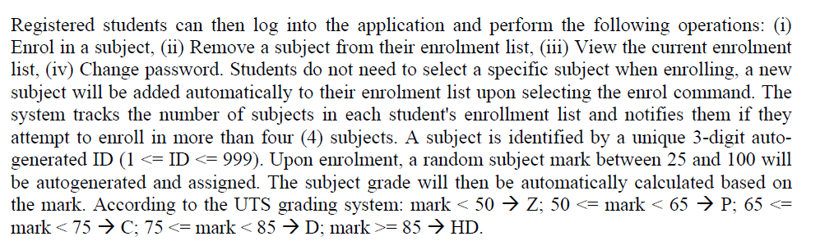
Group Assignment – Part 1: Student Operations After Registration – Clarified
Clarification of the Paragraph in Page 1
Once a student has registered, they can log in and do 4 main things:

Slide 39
Group Assignment – Part 1: Student Operations After Registration – Clarified
Enrol in a subject (system auto-adds a new subject, they don’t pick from a list).
Remove a subject.
View their current enrolment list.
Change their password.

Slide 40
Group Assignment – Part 1: Student Operations After Registration – Clarified
Each subject gets a 3-digit ID (like 007, 125), created by the system.
When a student enrols, the system also generates:
a random mark between 25–100,
and a grade (Z, P, C, D, HD) based on UTS rules.

Slide 41
Group Assignment – Part 1: Student Operations After Registration – Clarified
Students can only enrol in up to 4 subjects. If they try for more, the system shows an error.
All this info is stored in the file students.data.

Slide 42
Group Assignment – Part 1: Student Operations After Registration – Clarified
Example
Leila registers successfully.
She enrols in a subject → system assigns subject ID = 042, mark = 78, grade = D.
She enrols again → subject ID = 317, mark = 92, grade = HD.
Now her enrolment list shows:
Subject 042 → mark 78 → grade D
Subject 317 → mark 92 → grade HD
If she tries to enrol a 5th subject, system blocks it and shows: "You cannot enrol in more than 4 subjects."

Slide 43
Group Assignment – Part 1: Student Operations After Registration – Clarified
In Part 1 of the assignment, students don’t implement the code — they analyse this behaviour and turn it into:
User stories (e.g., “As a student, I enrol in a subject so that I can study it”).
Use case diagram (showing Student actor connected to “Enrol in Subject”).
Class diagram (showing classes like Student, Subject, Database).
Later, in Part 2, they will write the actual program that makes it work.

Slide 44
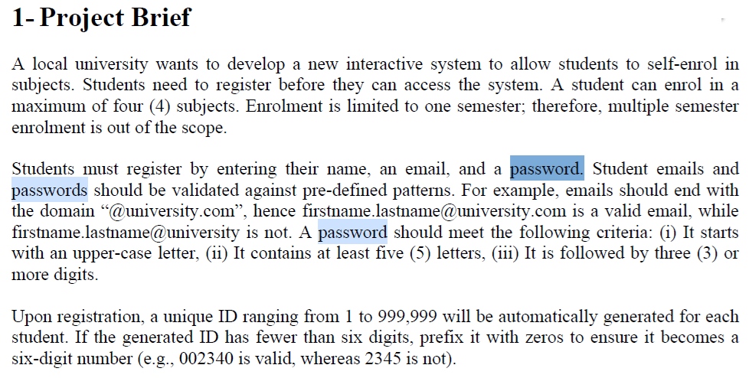
Group Assignment – Part 1: Password Rules – Clarified

Slide 45
Group Assignment – Part 1: Password Rules – Clarified
Clarification of Password Pattern
The password must start with an uppercase letter (e.g., A, B, Z).
After that, it must have at least 4 more letters (so minimum 5 letters in total including the first uppercase).

Slide 46
Finally, it must end with at least 3 digits (numbers).
✓ Example valid: Abcde123
X Invalid: abcde123 (no uppercase start), Ab12 (not enough letters), Abcdef (no digits).
So the shortest valid password looks like: Aaaaa111 → 8 characters total. Longer ones are also fine, as long as they follow the same pattern.

Slide 47
Group Assignment – Part 1: Password Rules – Clarified
What are actors?
In UML, actors are the people or external systems that interact with the application.
They are outside the system but they use it or get something from it.
In our assignment:
Student → can register, login, enrol, drop subject, view enrolments, change password.
Admin → can view students, group by grade, PASS/FAIL lists, remove students, clear data.

Slide 48
Group Assignment – Part 1: Password Rules – Clarified
So:
Actor = “who uses the system”.
Use case = “what they can do in the system.”

Slide 49
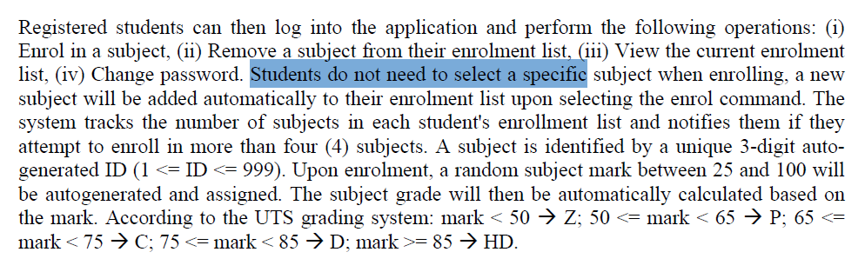
Group Assignment – Part 1: Password Rules – Clarified
2. If students register, will they manually pick a unit or automatically system will enrol them?
According to the brief:
“Students do not need to select a specific subject when enrolling, a new subject will be added automatically…”

Slide 50
Group Assignment – Part 1: Password Rules – Clarified
This means:
The system automatically generates a subject with an auto ID (3 digits).
It also gives the student a random mark (25–100) and then assigns a grade (Z, P, C, D, HD).
So students do not manually choose subjects.
They just click “enrol”, and the system adds a subject for them.

Slide 51
Group Assignment – Part 1: Password Rules – Clarified
In short,
Actors = Student + Admin.
Students don’t choose subjects manually; the system auto-enrols them when they select enrol.

Slide 52
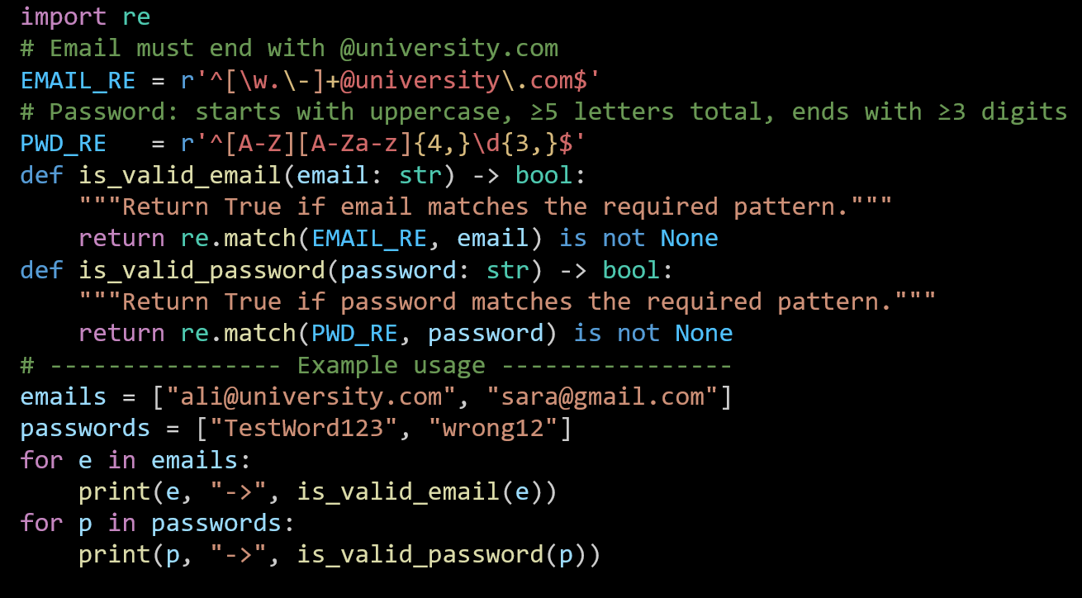
Mini Coding Nudges (Email/Password, Marks, Pass/Fail etc.)
Email & password patterns (Python):
1. import re Loads Python’s regular expression module.

Slide 53
Mini Coding Nudges (Email/Password, Marks, Pass/Fail etc.)
2. Patterns
^ start; $ end → match the whole string
[\w.\-]+ → one or more letters/digits/underscore/dot/hyphen before @
@university\.com → literal domain (the dot is escaped)
Email & password patterns (Python):

Slide 54
Mini Coding Nudges (Email/Password, Marks, Pass/Fail etc.)
Start with one uppercase [A-Z]
Then ≥4 letters [A-Za-z]{4,} → total letters ≥5
Then ≥3 digits \d{3,}
Anchored with ^ and $
Email & password patterns (Python):

Slide 55
Mini Coding Nudges (Email/Password, Marks, Pass/Fail etc.)
3. Validators
Return True/False depending on pattern match.
Email & password patterns (Python):

Slide 56
Mini Coding Nudges (Email/Password, Marks, Pass/Fail etc.)
4. Quick test Loops over sample emails/passwords and prints results.
Email & password patterns (Python):

Slide 57
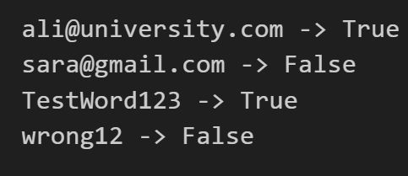
Mini Coding Nudges (Email/Password, Marks, Pass/Fail etc.)
Results:

Slide 58
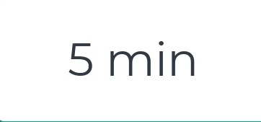
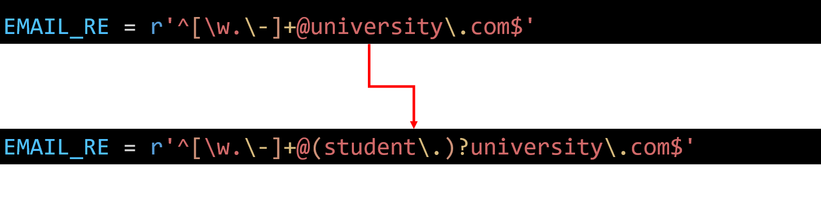
Mini Coding Nudges (Email/Password, Marks, Pass/Fail etc.)
Allow student. Subdomain too
Update the email rule so it accepts either @university.com or @student.university.com.

Slide 59
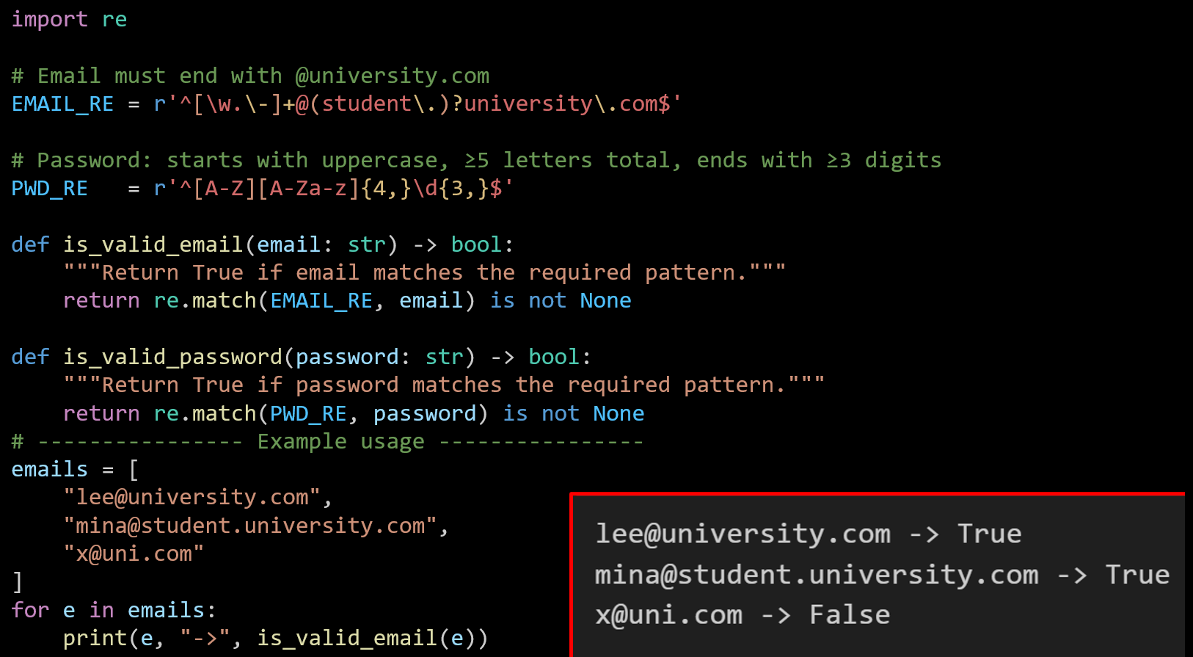

Slide 60
Allow optional - or _ before digits in password
Mini Coding Nudges (Email/Password, Marks, Pass/Fail etc.)
Change just the password regex line:
PWD_RE = r'^[A-Z][A-Za-z]{4,}\d{3,}$'
PWD_RE = r'^[A-Z][A-Za-z]{4,}[-_]?\d{3,}$'

Slide 61
Generate Random Marks and Assign Grades
Mini Coding Nudges (Email/Password, Marks, Pass/Fail etc.)
Write a function (grade(mark)) that takes a numeric mark and returns a grade (Z, P, C, D, HD) based on the mark range.
Generate a random mark between 25 and 100 using randint.
Generate a random student ID (padded with zeros to 3 digits).
Store the results in a dictionary with keys:
"id" → the random student ID
"mark" → the generated mark
"grade" → the grade returned by the function
Print the dictionary showing one student’s mark and grade.
In short, write a Python program that assigns a random mark to a student, calculates the grade, and prints the student’s ID, mark, and grade

Slide 62
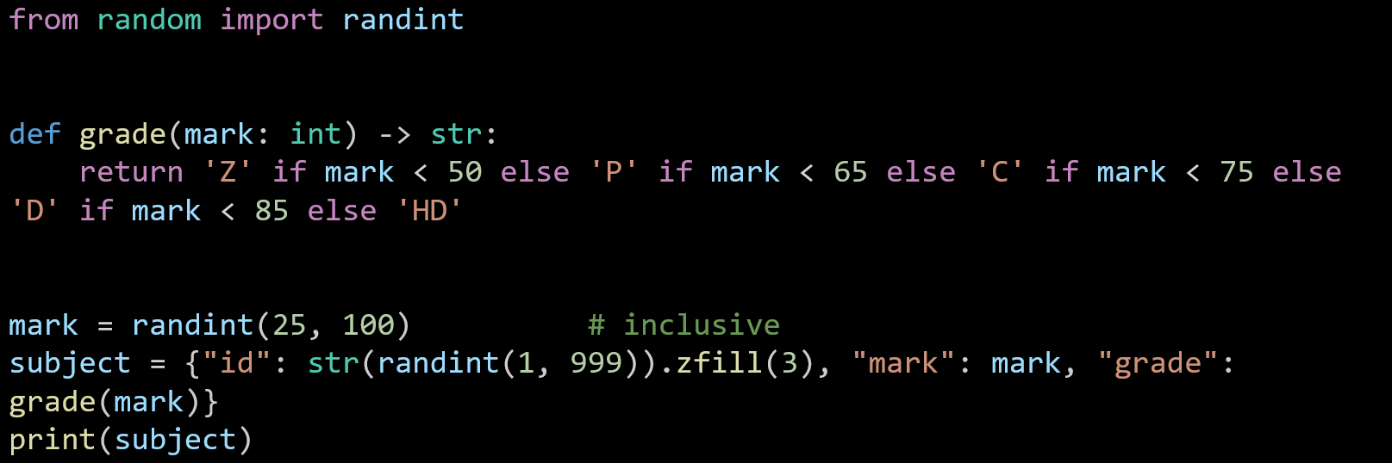
Generate Random Marks and Assign Grades
Mini Coding Nudges (Email/Password, Marks, Pass/Fail etc.)
Imports randint(a, b) to make random integers including both ends.

Slide 63
Generate Random Marks and Assign Grades
Mini Coding Nudges (Email/Password, Marks, Pass/Fail etc.)
A function that turns a numeric mark into a grade using the required bands:
<50 → Z, 50–64 → P, 65–74 → C, 75–84 → D, ≥85 → HD.

Slide 64
Generate Random Marks and Assign Grades
Mini Coding Nudges (Email/Password, Marks, Pass/Fail etc.)
Picks one random mark from 25 to 100.

Slide 65
Generate Random Marks and Assign Grades
Mini Coding Nudges (Email/Password, Marks, Pass/Fail etc.)
Creates a small record (a Python dict) for one subject:
"id" is a random number 1..999, padded to 3 digits like "007".
"mark" is the number above.
"grade" is computed by calling grade(mark).

Slide 66
Generate Random Marks and Assign Grades
Mini Coding Nudges (Email/Password, Marks, Pass/Fail etc.)
Prints something like: {'id': '087', 'mark': 78, 'grade': 'D'}.

Slide 67
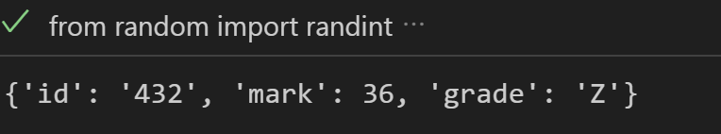
Generate Random Marks and Assign Grades
Mini Coding Nudges (Email/Password, Marks, Pass/Fail etc.)

Slide 68
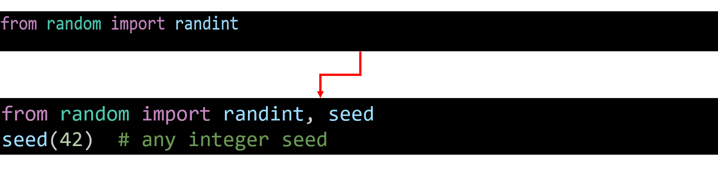
Make randomness reproducible
Mini Coding Nudges (Email/Password, Marks, Pass/Fail etc.)
Task: Add a seed so repeated runs give the same result (useful for testing).

Slide 69
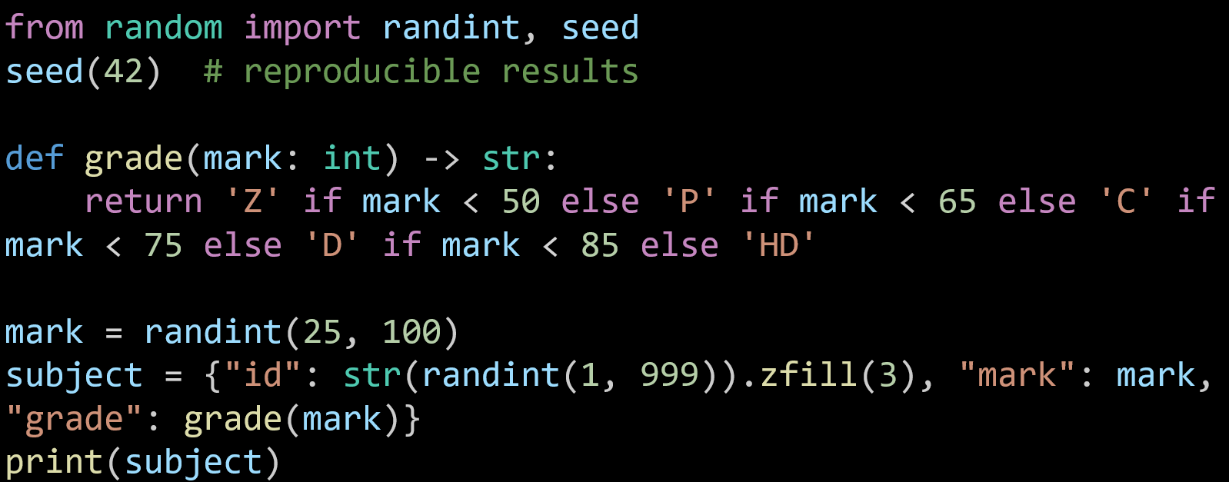
Brings in two functions from Python’s random library:
randint(a, b): makes a random whole number between a and b (both included).
seed(x): fixes the random numbers so you get the same result each time (useful for testing).

Slide 70
Sets the “starting point” for the random generator.
Without this, each run gives different results.
With it, the numbers repeat every time, which makes testing easier.

Slide 71
Defines a function called grade:
Input: a number (mark) between 25–100.
Output: a single letter grade, based on rules:
<50 → 'Z'
50–64 → 'P'
65–74 → 'C'
75–84 → 'D'
≥85 → 'HD'

Slide 72
Generates one random exam mark between 25 and 100 and stores it in the variable mark.

Slide 73
Creates a dictionary (like a mini record) for one subject:
"id" → random number 1–999, but .zfill(3) pads it with zeros so it always looks like 001, 045, 234.
"mark" → the random mark generated above.
"grade" → the letter grade, calculated by calling grade(mark).

Slide 74
Shows the whole dictionary on screen.

Slide 75
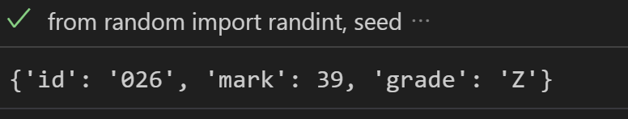
Make randomness reproducible
Mini Coding Nudges (Email/Password, Marks, Pass/Fail etc.)
In short:
Fix the random seed,
Generate a random mark + subject ID,
Work out the grade,
Print the record.
from random import randint, seed
seed(42) # reproducible results
def grade(mark: int) -> str:
return 'Z' if mark < 50 else 'P' if mark < 65 else 'C' if mark < 75 else 'D' if mark < 85 else 'HD'
mark = randint(25, 100)
subject = {"id": str(randint(1, 999)).zfill(3), "mark": mark, "grade": grade(mark)}
print(subject)

Slide 76
Add student ID and PASS/FAIL
Mini Coding Nudges (Email/Password, Marks, Pass/Fail etc.)
Task: Add a 6-digit student ID and a pass/fail flag (pass if mark ≥ 50). Hint: Use zfill(6) for the student ID.

Slide 77
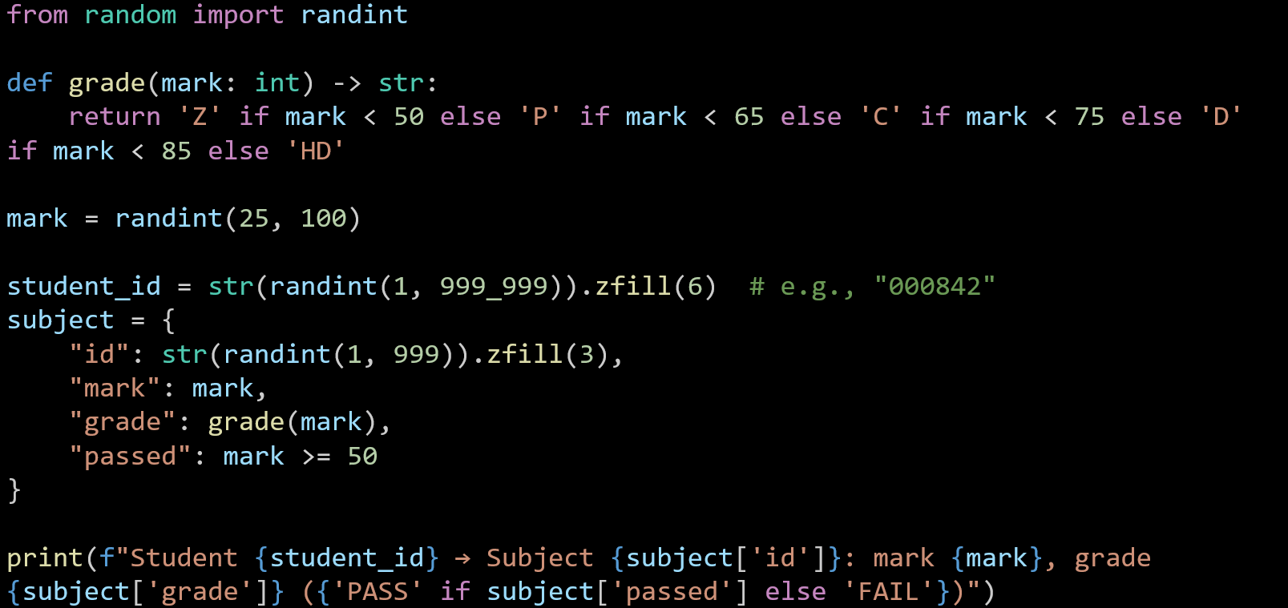
Mini Coding Nudges (Email/Password, Marks, Pass/Fail etc.)

Slide 78
Mini Coding Nudges (Email/Password, Marks, Pass/Fail etc.)
Student 256788 → Subject 229: mark 60, grade P (PASS)

Slide 79
Grade Classification Based on University Rules
Mini Coding Nudges (Email/Password, Marks, Pass/Fail etc.)
Write a function grade(mark: int) -> str that returns the grade according to UTS rules.
Use if–else conditions (or chained expressions).
Test your function with example marks [42, 58, 70, 82, 95].
Print each mark alongside its grade.
You’ve basically turned the earlier randomised activity into a deterministic grading demo — perfect for classroom explanation before students move to random generation.

Slide 80
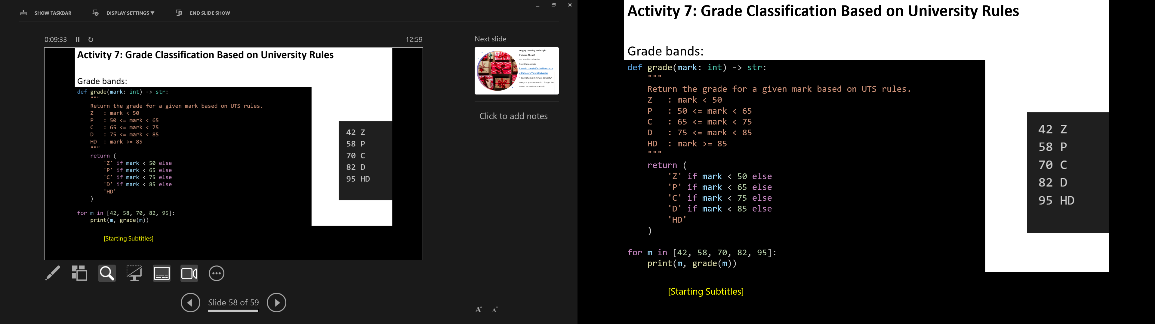
Mini Coding Nudges (Email/Password, Marks, Pass/Fail etc.)
mark: int -> str are type hints: input is an integer, output is a string.
The big return uses a chain of checks from lowest to highest.

Slide 81
Mini Coding Nudges (Email/Password, Marks, Pass/Fail etc.)
Python evaluates them in order:
If mark < 50, stop and return 'Z'.
Otherwise, if mark < 65, return 'P'.
Otherwise, if mark < 75, return 'C'.
Otherwise, if mark < 85, return 'D'.
Otherwise (so mark ≥ 85), return 'HD'.

Slide 82
Mini Coding Nudges (Email/Password, Marks, Pass/Fail etc.)
Boundaries (exact edges)
50 → P (not Z)
65 → C
75 → D
85 → HD

Slide 83
Mini Coding Nudges (Email/Password, Marks, Pass/Fail etc.)
That’s all—it’s just a top-to-bottom check that stops at the first band that fits.

Slide 84
Group Assignment – Part 2: Build hints (Python-first, JavaFX minority)
Python CLI structure (suggestion):
models/Student.py, Subject.py
services/auth.py, id_gen.py, grade.py, store.py
cli/university_menu.py, student_menu.py, admin_menu.py
Data file: students.data (JSONL).
Keep regex as constants; wrap file I/O with try/except; always re-write the file after CRUD.

Slide 85
Group Assignment – Part 2: Build hints (Python-first, JavaFX minority)
JavaFX (optional challenge later):
MVC folders: model/, controller/, view/ (FXML).
Start with login window → enrolment window.
Read registered students from students.data.

Slide 86
Group Assignment – Part 2: Build hints (Python-first, JavaFX minority)
Coding do/avoid:
Do unit-size functions (e.g., assign_mark_and_grade()), no giant methods.
Do input validation; mirror sample I/O wording.
Avoid plaintext passwords in examples (hash in design; for Part 2, at minimum note hashing TODO).
Avoid mixing model and menu logic; keep menus thin.

Slide 87
Group Assignment – Part 3: Showcase tips
Plan a 5–7 min script:
Open app → show University → Student/Admin navigation.
Student flow: register/login → enrol (cap at 4) → show → remove → change password.
Admin flow: list → group by grade → PASS/FAIL → remove → clear.
Code walkthrough: each member shows their class/function for ~45–60s (what it does, where it’s called). Avoid: live debugging on stage; changing scope; reading long code blocks.

Slide 88
Reference Note for Students
The main reference for this assignment is the official instructions provided on Canvas: Assignments – Part 1: Analysis and Design
This PowerPoint is designed to guide you and clarify the task where things might feel confusing. If you are ever unsure, please always go back to the official Canvas instructions as the source of truth.

Slide 89
Lab 6 Exercises
lab time: 120 minutes
Lab 6 has two objectives:
Primary: Implement the DeskBankApp [refer to Lab 5]
Secondary: Complete the practice exercises [1 and 2]
Complete the Lab 6 exercises using either Java or Python.
Recommended IDE for Java and Python: vscode

Slide 90
Lab 6 Exercises
Case Study: Develop the DeskBankApp system – Fourth Implementation
This exercise is the Fourth implementation of the DeskBankApp case study
Sample I/O
(show and incorrect command)
The Bank class is the main system class. Move the functionality methods (procedures and functions) to the appropriate classes (Customer, Account) and update the Bank, Account, and Customer classes as follows:
The Bank Class:
- has one Customer (name = “John Smith”)
- uses the methods defined in the Customer class in its system menu, or menu() function
- The main() method in Bank executes menu() with the following options:
( d ) make a deposit
(w ) make a withdraw
( t ) make a transfer
( s ) show balance
( x ) exit the system
Initial Savings balance: $1000
Initial Loan balance: $2000
Customer menu (d/w/t/s/x): s
John Smith accounts:
Savings account has $1,000.00
Loan account has $2,000.00
Customer menu (d/w/t/s/x): k
Menu options
d = deposit
w = withdraw
t = transfer
s = show
x = exit

Slide 91
Lab 6 Exercises
Case Study - continued: Develop the DeskBankApp system – Fourth Implementation
The Account class has the following properties:
Account has a type (String) and balance (double)
Account constructor initializes type from parameter and balance from STDIN
Account has the following operations:
- a function to read the initial balance from STDIN
- a procedure to make a deposit of a given amount
- a procedure to make a withdraw of a given amount
- a function to check if the current balance is greater than or equal to a certain amount
- a function to transfer amount to another account
- a function to return account information formatted as:
<type> balance $:<balance>
Sample I/O
(deposit and withdraw)
Customer menu (d/w/t/s/x): d
Amount to deposit: $1000
Customer menu (d/w/t/s/x): s
John Smith accounts:
Savings account has $2,000.00
Loan account has $2,000.00
Customer menu (d/w/t/s/x): w
Amount to withdraw: $5000
Insufficient funds
Customer menu (d/w/t/s/x): w
Amount to withdraw: $500
Customer menu (d/w/t/s/x): s
John Smith accounts:
Savings account has $1,500.00
Loan account has $2,000.00

Slide 92
Lab 6 Exercises
Case Study - continued: Develop the DeskBankApp system – Fourth Implementation
The Customer class has the following properties:
Customer has a name (String), has a savings (Account), and a loan (Account)
The Customer constructor initializes the name field from parameter and a Savings and a Loan Accounts using the Account constructor.
Customer has the following functionalities to perform Account operations:
- a function to read the amount from STDIN
- a procedure to withdraw an amount read from STDIN from the Savings Account
- a procedure to deposit an amount read from STDIN to the Savings Account
- a procedure to show the account balance
- a function to transfer an amount read from STDIN from the Savings Account to the Loan account
- a function to return the account information formatted as: <name> accounts:
Savings account has $<balance>
Loan account has $<balance>
Sample I/O
(transfer and exit)
Customer menu (d/w/t/s/x): t
Amount to transfer: $5000
Insufficient funds
Customer menu (d/w/t/s/x): t
Amount to transfer: $500
Customer menu (d/w/t/s/x): s
John Smith accounts:
Savings account has $1,000.00
Loan account has $1,500.00
Customer menu (d/w/t/s/x): x
Done

Slide 93
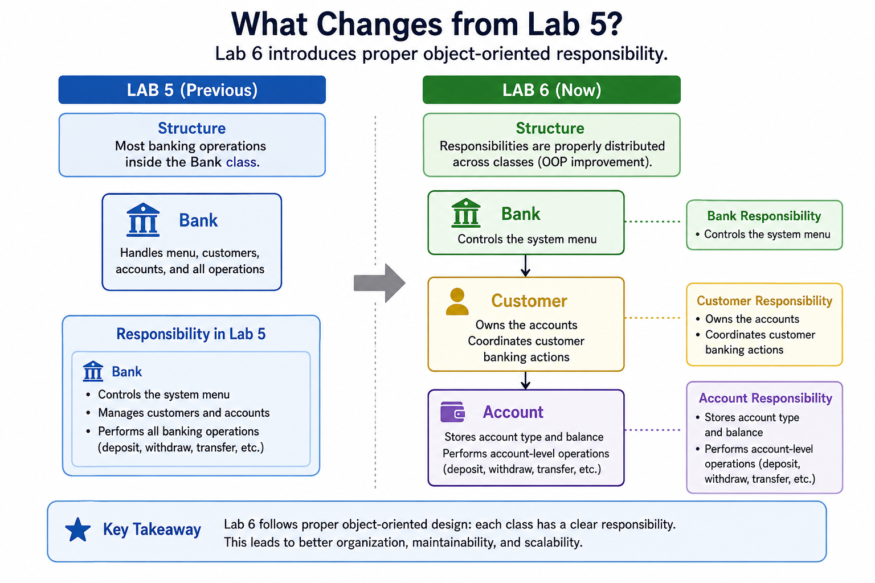
Lab 6 Exercises

Slide 94
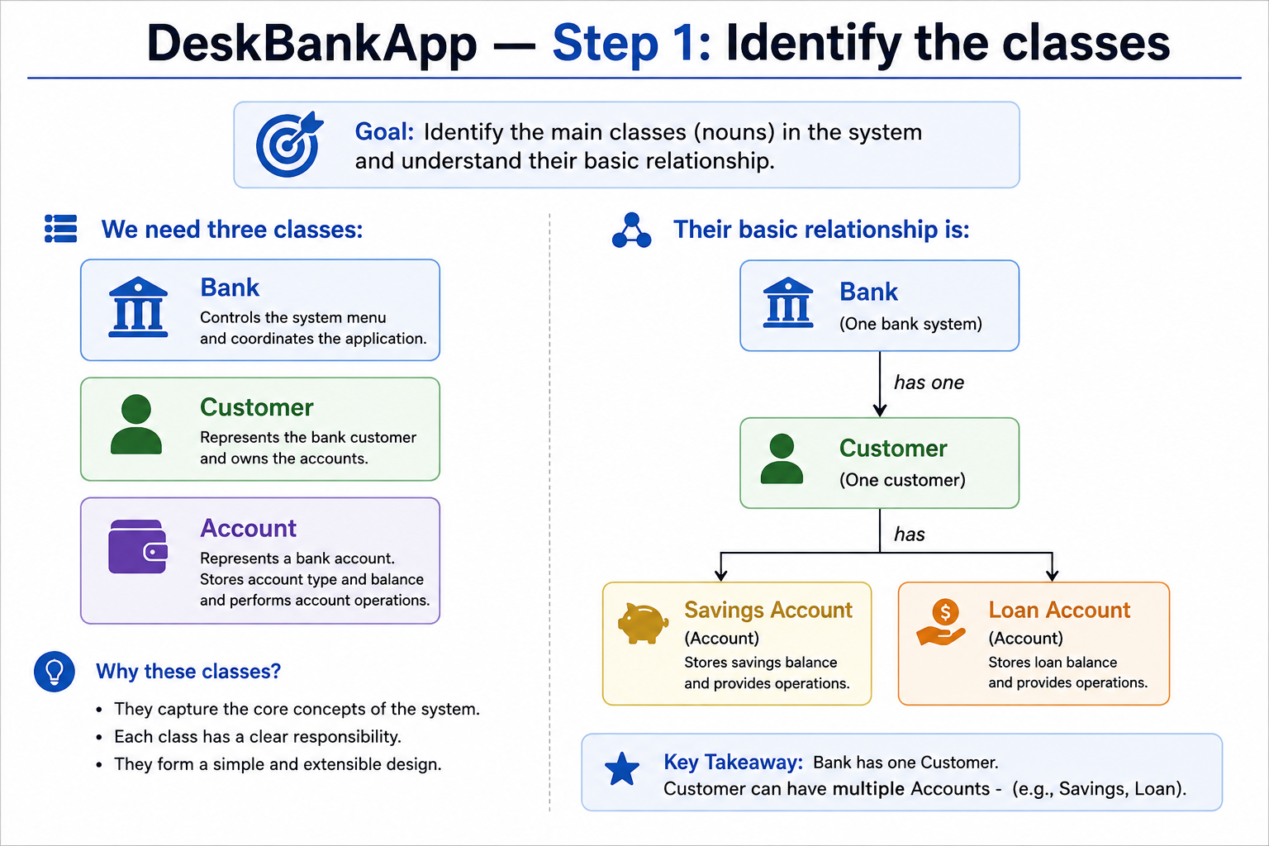
Lab 6 Exercises

Slide 95
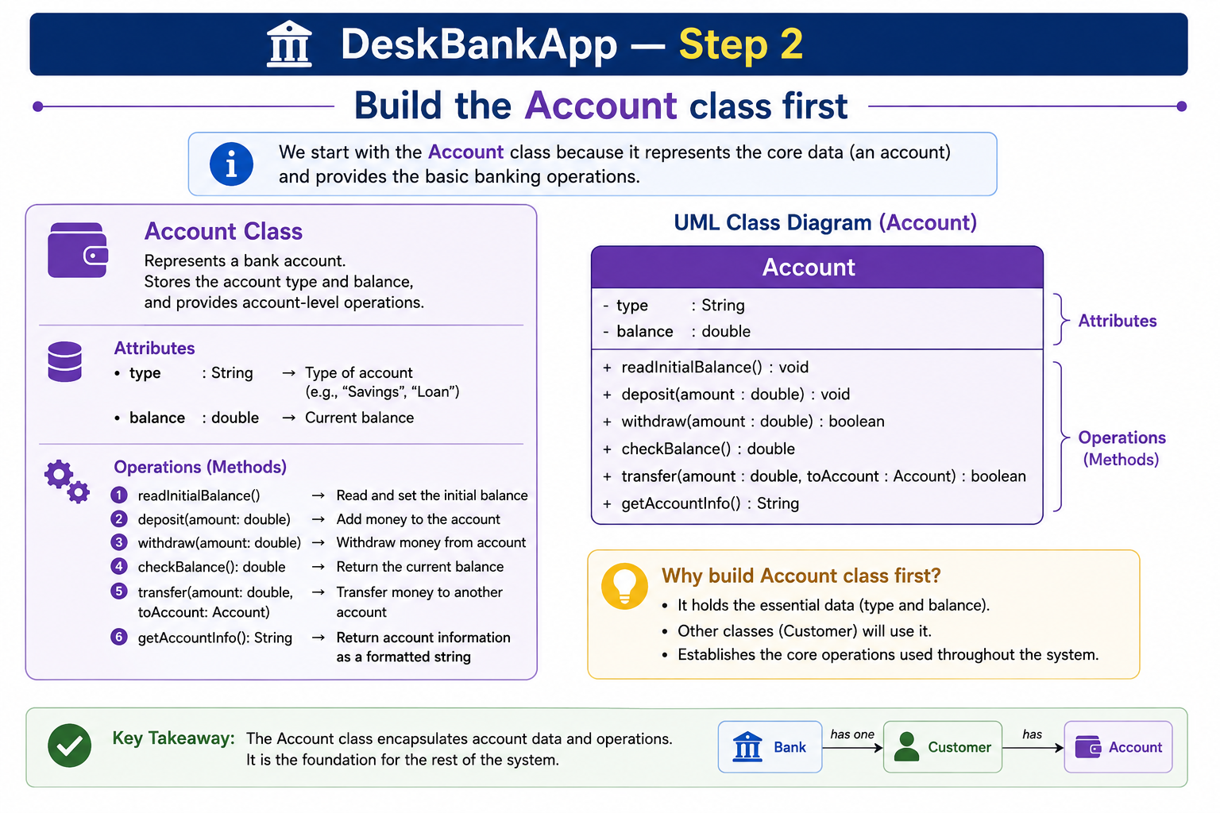
Lab 6 Exercises

Slide 96
Lab 6 Exercises
Python
Start with:
class Account:
pass
Now add the constructor:
class Account:
def __init__(self, account_type):
self.type = account_type
self.balance = self.read_initial_balance()
What does this do?
If we create:
savings = Account("Savings")
the account remembers:
type = "Savings"
and asks the user to enter its starting balance.

Slide 97
Lab 6 Exercises
Step 3 — Read the initial balance
Python
def read_initial_balance(self):
return float(input(f"Initial {self.type} balance: $"))
So creating:
Account("Savings")
may produce:
Initial Savings balance: $1000

Slide 98
Lab 6 Exercises
Java
import java.util.Scanner;
public class Account {
private String type;
private double balance;
public Account(
String type,
Scanner input) {
this.type = type;
this.balance =
readInitialBalance(input);
}
private double readInitialBalance(
Scanner input) {
System.out.print(
"Initial "
+ type
+ " balance: $"
);
return input.nextDouble();
}
}

Slide 99
Lab 6 Exercises
Step 4 — Add deposit()
A deposit increases the account balance.
Python
def deposit(self, amount):
self.balance += amount
Example:
Balance = 1000
Deposit = 500
New balance = 1500
Java
public void deposit(double amount) {
balance += amount;
}

Slide 100
Lab 6 Exercises
Step 5 — Add sufficient-funds checking
The requirement says:
Check whether current balance is greater than or equal to an amount.
Python
def has(self, amount):
return self.balance >= amount
This returns either:
True
or: False
Java
public boolean has(double amount) {
return balance >= amount;
}

Slide 101
Lab 6 Exercises
Java
public void withdraw(double amount) {
if (!has(amount)) {
throw new IllegalArgumentException(
"Insufficient funds"
);
}
balance -= amount;
}
Step 6 — Add withdraw()
Python
def withdraw(self, amount):
if not self.has(amount):
raise ValueError("Insufficient funds")
self.balance -= amount
Notice that withdraw() reuses: self.has(amount)
instead of repeating the balance check.

Slide 102
Step 7 — Add account information
The brief gives one wording, while the sample output uses:
Savings account has $1,000.00
I would follow the sample output for consistency.
Python
def __str__(self):
return (f"{self.type} account has "f"${self.balance:,.2f}")
:,.2f means:
comma separator
two decimal places
Example: 2000
becomes: 2,000.00
Java
@Override
public String toString() {
return String.format(
"%s account has $%,.2f",
type,
balance
);
}

Slide 103
Step 8 — Account transfer behaviour
A normal transfer would usually do this:
source balance -= amount
destination balance += amount
But the supplied DeskBankApp example is a loan payment:
Savings decreases
Loan debt also decreases
Therefore, for this lab we can define:
Python
def transfer_to_loan(self, amount, loan_account):
if not self.has(amount):
raise ValueError("Insufficient funds")
if not loan_account.has(amount):
raise ValueError("Transfer exceeds loan balance")
self.withdraw(amount)
loan_account.withdraw(amount)

Slide 104
Lab 6 Exercises
Java
public void transferToLoan(
double amount,
Account loanAccount) {
if (!has(amount)) {
throw new IllegalArgumentException(
"Insufficient funds"
);
}
if (!loanAccount.has(amount)) {
throw new IllegalArgumentException(
"Transfer exceeds loan balance"
);
}
withdraw(amount);
loanAccount.withdraw(amount);
}
That matches the supplied example.

Slide 105
Completed Account Class — Python
class Account:
def __init__(self, account_type):
self.type = account_type
self.balance = (
self.read_initial_balance()
)
def read_initial_balance(self):
return float(
input(
f"Initial {self.type} "
f"balance: $"
)
)
def deposit(self, amount):
self.balance += amount
def has(self, amount):
return self.balance >= amount
def withdraw(self, amount):
if not self.has(amount):
raise ValueError(
"Insufficient funds"
)
self.balance -= amount
def transfer_to_loan(
self,
amount,
loan_account):
if not self.has(amount):
raise ValueError(
"Insufficient funds"
)
if not loan_account.has(amount):
raise ValueError(
"Transfer exceeds loan balance"
)
self.withdraw(amount)
loan_account.withdraw(amount)
def __str__(self):
return (
f"{self.type} account has "
f"${self.balance:,.2f}"
)
Completed Account Class — Java
import java.util.Scanner;
public class Account {
private String type;
private double balance;
public Account(
String type,
Scanner input) {
this.type = type;
this.balance =
readInitialBalance(input);
}
private double readInitialBalance(
Scanner input) {
System.out.print(
"Initial "
+ type
+ " balance: $"
);
return input.nextDouble();
}
public void deposit(double amount) {
balance += amount;
}
public boolean has(double amount) {
return balance >= amount;
}
public void withdraw(double amount) {
if (!has(amount)) {
throw new IllegalArgumentException(
"Insufficient funds"
);
}
balance -= amount;
}
public void transferToLoan(
double amount,
Account loanAccount) {
if (!has(amount)) {
throw new IllegalArgumentException(
"Insufficient funds"
);
}
if (!loanAccount.has(amount)) {
throw new IllegalArgumentException(
"Transfer exceeds loan balance"
);
}
withdraw(amount);
loanAccount.withdraw(amount);
}
@Override
public String toString() {
return String.format(
"%s account has $%,.2f",
type,
balance
);
}
}

Slide 106
Customer Class
The Customer has:
name
Savings Account
Loan Account
Its responsibilities are:
read amount
deposit
withdraw
transfer
show accounts
return customer account information

Slide 107
Step 9 — Create the Customer constructor
Python
class Customer:
def __init__(self, name):
self.name = name
self.savings = Account("Savings")
self.loan = Account("Loan")
Creating:
Customer("John Smith")
automatically creates both accounts.

Slide 108
Java
public class Customer {
private String name;
private Account savings;
private Account loan;
public Customer(
String name,
Scanner input) {
this.name = name;
savings =
new Account(
"Savings",
input
);
loan =
new Account(
"Loan",
input
);
}
}

Slide 109
Lab 6 Exercises
Step 10 — Read a transaction amount
Python
def read_amount(self, message):
return float(input(message))
This method is reusable.
For example:
amount = self.read_amount("Amount to deposit: $")
Java
private double readAmount(
Scanner input,
String message) {
System.out.print(message);
return input.nextDouble();
}

Slide 110
Lab 6 Exercises
Step 11 — Customer deposit()
The requirement says customer deposits go into Savings.
Python
def deposit(self):
amount = self.read_amount("Amount to deposit: $")
self.savings.deposit(amount)

Slide 111
Lab 6 Exercises
Java
public void deposit(
Scanner input) {
double amount =
readAmount(
input,
"Amount to deposit: $"
);
savings.deposit(amount);
}

Slide 112
Lab 6 Exercises
Step 12 — Customer withdraw()
Python
def withdraw(self):
amount = self.read_amount("Amount to withdraw: $")
try:
self.savings.withdraw(amount)
except ValueError as error:
print(error)

Slide 113
Lab 6 Exercises
Step 13 — Customer transfer()
Python
def transfer(self):
amount = self.read_amount("Amount to transfer: $")
try:
self.savings.transfer_to_loan(amount, self.loan)
except ValueError as error:
print(error)

Slide 114
Lab 6 Exercises
Java
public void transfer(
Scanner input) {
double amount =
readAmount(
input,
"Amount to transfer: $"
);
try {
savings.transferToLoan(
amount,
loan
);
} catch (
IllegalArgumentException error
) {
System.out.println(
error.getMessage()
);
}
}

Slide 115
Lab 6 Exercises
Step 14 — Customer show()
Python
def show(self):
print(self)
Then define:
def __str__(self):
return (f"{self.name} accounts:\n"f"{self.savings}\n"f"{self.loan}")

Slide 116
Lab 6 Exercises
Java
public void show() {
System.out.println(this);
}
and:
@Override
public String toString() {
return name
+ " accounts:\n"
+ savings
+ "\n"
+ loan;
}

Slide 117
Lab 6 Exercises
Completed Customer Class — Python
class Customer:
def __init__(self, name):
self.name = name
self.savings = Account("Savings")
self.loan = Account("Loan")
def read_amount(self, message):
return float(input(message))
def deposit(self):
amount = self.read_amount("Amount to deposit: $")
self.savings.deposit(amount)
def withdraw(self):
amount = self.read_amount("Amount to withdraw: $")
try:
self.savings.withdraw(amount)
except ValueError as error:
print(error)
def transfer(self):
amount = self.read_amount("Amount to transfer: $")
try:
self.savings.transfer_to_loan(amount, self.loan)
except ValueError as error:
print(error)
def show(self):
print(self)
def __str__(self):
return (
f"{self.name} accounts:\n"
f"{self.savings}\n"
f"{self.loan}"
)

Slide 118
Completed Customer Class — Java
import java.util.Scanner;
public class Customer {
private String name;
private Account savings;
private Account loan;
public Customer(
String name,
Scanner input) {
this.name = name;
savings =
new Account(
"Savings",
input
);
loan =
new Account(
"Loan",
input
);
}
private double readAmount(
Scanner input,
String message) {
System.out.print(message);
return input.nextDouble();
}
public void deposit(
Scanner input) {
double amount =
readAmount(
input,
"Amount to deposit: $"
);
savings.deposit(amount);
}

Slide 119
public void withdraw(
Scanner input) {
double amount =
readAmount(
input,
"Amount to withdraw: $"
);
try {
savings.withdraw(amount);
} catch (
IllegalArgumentException error
) {
System.out.println(
error.getMessage()
);
}
}
public void transfer(
Scanner input) {
double amount =
readAmount(
input,
"Amount to transfer: $"
);
try {
savings.transferToLoan(
amount,
loan
);
} catch (
IllegalArgumentException error
) {
System.out.println(
error.getMessage()
);
}
}

Slide 120
public void show() {
System.out.println(this);
}
@Override
public String toString() {
return name
+ " accounts:\n"
+ savings
+ "\n"
+ loan;
}
}

Slide 121
Lab 6 Exercises
Bank Class
The Bank class is now much simpler.
It:
has one Customer
shows the menu
calls Customer methods
That is good OOP design.

Slide 122
Lab 6 Exercises
Step 15 — Create John Smith
Python
class Bank:
def __init__(self):
self.customer = Customer("John Smith")
Java
private Customer customer;
public Bank(Scanner input) {
customer =
new Customer(
"John Smith",
input
);
}

Slide 123
Lab 6 Exercises
Step 16 — Add help()
The sample says an invalid command such as k should display:
Menu options
d = deposit
w = withdraw
t = transfer
s = show
x = exit
Python
def help(self):
print("Menu options")
print("d = deposit")
print("w = withdraw")
print("t = transfer")
print("s = show")
print("x = exit")

Slide 124
Step 17 — Build menu()
Python
def menu(self):
while True:
choice = input("Customer menu ""(d/w/t/s/x): ").lower()
if choice == "d":
self.customer.deposit()
elif choice == "w":
self.customer.withdraw()
elif choice == "t":
self.customer.transfer()
elif choice == "s":
self.customer.show()
elif choice == "x":
print("Done")
break
else:
self.help()

Slide 125
Java
public void menu(
Scanner input) {
input.nextLine();
while (true) {
System.out.print(
"Customer menu "
+ "(d/w/t/s/x): "
);
String choice =
input.nextLine()
.toLowerCase();
switch (choice) {
case "d":
customer.deposit(input);
input.nextLine();
break;
case "w":
customer.withdraw(input);
input.nextLine();
break;
case "t":
customer.transfer(input);
input.nextLine();
break;
case "s":
customer.show();
break;
case "x":
System.out.println("Done");
return;
default:
help();
}
}
}

Slide 126
Completed Python DeskBankApp
For beginners, you may keep all three classes in one file initially:
class Account:
def __init__(self, account_type):
self.type = account_type
self.balance = (self.read_initial_balance())
def read_initial_balance(self):
return float(
input(f"Initial {self.type} "f"balance: $"))
def deposit(self, amount):
self.balance += amount
def has(self, amount):
return self.balance >= amount
def withdraw(self, amount):
if not self.has(amount):
raise ValueError("Insufficient funds")
self.balance -= amount
def transfer_to_loan(
self,
amount,
loan_account):
if not self.has(amount):
raise ValueError("Insufficient funds")
if not loan_account.has(amount):
raise ValueError("Transfer exceeds loan balance")
self.withdraw(amount)
loan_account.withdraw(amount)
def __str__(self):
return (
f"{self.type} account has "
f"${self.balance:,.2f}"
)
class Customer:
def __init__(self, name):
self.name = name
self.savings = Account("Savings")
self.loan = Account("Loan")
def read_amount(
self,
message):

Slide 127
return float(input(message))
def deposit(self):
amount = self.read_amount("Amount to deposit: $")
self.savings.deposit(amount)
def withdraw(self):
amount = self.read_amount("Amount to withdraw: $")
try:
self.savings.withdraw(amount)
except ValueError as error:
print(error)
def transfer(self):
amount = self.read_amount("Amount to transfer: $")
try:
self.savings.transfer_to_loan(amount, self.loan)
except ValueError as error:
print(error)
def show(self):
print(self)
def __str__(self):
return (
f"{self.name} accounts:\n"
f"{self.savings}\n"
f"{self.loan}"
)
class Bank:
def __init__(self):
self.customer = Customer("John Smith")
def help(self):
print("Menu options")
print("d = deposit")
print("w = withdraw")
print("t = transfer")
print("s = show")
print("x = exit")
def menu(self):
while True:
choice = input(
"Customer menu "
"(d/w/t/s/x): "
).lower()

Slide 128
if choice == "d":
self.customer.deposit()
elif choice == "w":
self.customer.withdraw()
elif choice == "t":
self.customer.transfer()
elif choice == "s":
self.customer.show()
elif choice == "x":
print("Done")
break
else:
self.help()
def main():
bank = Bank()
bank.menu()
if __name__ == "__main__":
main()

Slide 129
Completed Java DeskBankApp
For Java, I recommend three files:
Account.java
Customer.java
Bank.java
Account.java
import java.util.Scanner;
public class Account {
private String type;
private double balance;
public Account(
String type,
Scanner input) {
this.type = type;
this.balance =
readInitialBalance(input);
}
private double readInitialBalance(
Scanner input) {
System.out.print(
"Initial "
+ type
+ " balance: $"
);
return input.nextDouble();
}
public void deposit(double amount) {
balance += amount;
}
public boolean has(double amount) {
return balance >= amount;
}
public void withdraw(double amount) {
if (!has(amount)) {
throw new IllegalArgumentException(
"Insufficient funds"
);
}
balance -= amount;
}

Slide 130
public void transferToLoan(
double amount,
Account loanAccount) {
if (!has(amount)) {
throw new IllegalArgumentException(
"Insufficient funds"
);
}
if (!loanAccount.has(amount)) {
throw new IllegalArgumentException(
"Transfer exceeds loan balance"
);
}
withdraw(amount);
loanAccount.withdraw(amount);
}
@Override
public String toString() {
return String.format(
"%s account has $%,.2f",
type,
balance
);
}
}
Customer.java
import java.util.Scanner;
public class Customer {
private String name;
private Account savings;
private Account loan;
public Customer(
String name,
Scanner input) {
this.name = name;
savings =
new Account(
"Savings",
input
);
loan =
new Account(
"Loan",
input
);
}

Slide 131
private double readAmount(
Scanner input,
String message) {
System.out.print(message);
return input.nextDouble();
}
public void deposit(
Scanner input) {
double amount =
readAmount(
input,
"Amount to deposit: $"
);
savings.deposit(amount);
}
public void withdraw(
Scanner input) {
double amount =
readAmount(
input,
"Amount to withdraw: $"
);
try {
savings.withdraw(amount);
} catch (
IllegalArgumentException error
) {
System.out.println(
error.getMessage()
);
}
}
public void transfer(
Scanner input) {
double amount =
readAmount(
input,
"Amount to transfer: $"
);
try {
savings.transferToLoan(
amount,
loan
);

Slide 132
} catch (
IllegalArgumentException error
) {
System.out.println(
error.getMessage()
);
}
}
public void show() {
System.out.println(this);
}
@Override
public String toString() {
return name
+ " accounts:\n"
+ savings
+ "\n"
+ loan;
}
}
Bank.java
import java.util.Scanner;
public class Bank {
private Customer customer;
public Bank(
Scanner input) {
customer =
new Customer(
"John Smith",
input
);
}
public void help() {
System.out.println(
"Menu options"
);
System.out.println(
"d = deposit"
);
System.out.println(
"w = withdraw"
);
System.out.println(
"t = transfer"
);

Slide 133
System.out.println(
"s = show"
);
System.out.println(
"x = exit"
);
}
public void menu(
Scanner input) {
input.nextLine();
while (true) {
System.out.print(
"Customer menu "
+ "(d/w/t/s/x): "
);
String choice =
input.nextLine()
.toLowerCase();
switch (choice) {
case "d":
customer.deposit(
input
);
input.nextLine();
break;
case "w":
customer.withdraw(
input
);
input.nextLine();
break;
case "t":
customer.transfer(
input
);
input.nextLine();
break;
case "s":
customer.show();
break;
case "x":
System.out.println(
"Done"
);

Slide 134
return;
default:
help();
}
}
}
public static void main(
String[] args) {
Scanner input =
new Scanner(System.in);
Bank bank =
new Bank(input);
bank.menu(input);
input.close();
}
}

Slide 135
Lab 6 Exercises
Develop the program Lab6Exercise1 that contains the following two steps:
Step 1: Develop the class Person
Person has a name and an age
Define a constructor to initialize the name and age fields to default
Define a constructor to initialize the fields from parameters
Define accessors/mutators for the fields
Override toString() to return: “<name> age is <age>”

Slide 136
Lab 6 Exercises
Step 2: Develop the class People
People has two person fields
- The first person is initialized using default constructor
- The second person is initialized using the constructor with parameters
The argument-values for this constructor should be read from keyboard
Define a method called ‘show’ that outputs a person’s information
Define a method ‘update’ that updates the name of a person
Define the main() method with the following functionalities: 1) create a People instance, 2) Show each person’s information, 3) Update each person’s name with the values read from the keyboard then show their information again

Slide 137
Lab 6 Exercises
Lab 6 Exercise 1 — Person and People
This exercise teaches:
classes and objects
constructors
constructor overloading
getters/setters
toString()
object composition

Slide 138
Step 1 — Person fields
Person needs:
name
age
Python
class Person:
def __init__(
self,
name="Unknown",
age=0):
self.name = name
self.age = age
Python uses default parameter values instead of Java-style overloaded constructors.

Slide 139
Let’s use:
Unknown
0
because the exercise does not specify the default values.
Java
public class Person {
private String name;
private int age;
}

Slide 140
Step 2 — Add constructors
Python
The one constructor supports both:
Person()
and:
Person("Alice", 25)
because of:
name="Unknown"
age=0

Slide 141
Java
Default constructor:
public Person() {
name = "Unknown";
age = 0;
}
Parameterized constructor:
public Person(
String name,
int age) {
this.name = name;
this.age = age;
}
This is constructor overloading.

Slide 142
Step 3 — Add accessors
An accessor reads a field.
Python
def get_name(self):
return self.name
def get_age(self):
return self.age
Java
public String getName() {
return name;
}
public int getAge() {
return age;
}

Slide 143
Step 4 — Add mutators
A mutator changes a field.
Python
def set_name(self, name):
self.name = name
def set_age(self, age):
self.age = age
Java
public void setName(
String name) {
this.name = name;
}
public void setAge(
int age) {
this.age = age;
}

Slide 144
Step 5 — Add descriptive output
Python
def __str__(self):
return (
f"{self.name} "
f"age is {self.age}"
)
Java
@Override
public String toString() {
return name
+ " age is "
+ age;
}

Slide 145
Completed Person — Python
class Person:
def __init__(
self,
name="Unknown",
age=0):
self.name = name
self.age = age
def get_name(self):
return self.name
def get_age(self):
return self.age
def set_name(
self,
name):
self.name = name
def set_age(
self,
age):
self.age = age
def __str__(self):
return (
f"{self.name} "
f"age is {self.age}"
)
Completed Person — Java
public class Person {
private String name;
private int age;
public Person() {
name = "Unknown";
age = 0;
}
public Person(
String name,
int age) {
this.name = name;
this.age = age;
}
public String getName() {
return name;
}
public int getAge() {
return age;
}
public void setName(
String name) {
this.name = name;
}
public void setAge(
int age) {
this.age = age;
}
@Override
public String toString() {
return name
+ " age is "
+ age;
}
}

Slide 146
Exercise 1 — Step 6: Build People
People contains two Person objects.
The first uses:
default constructor
The second uses:
parameterized constructor
with keyboard input.
Python
class People:
def __init__(self):
self.person1 = Person()
name = input("Enter second person's name: ")
age = int(input("Enter second person's age: "))
self.person2 = Person(name, age)

Slide 147
Java
public class People {
private Person person1;
private Person person2;
public People(
Scanner input) {
person1 =
new Person();
System.out.print(
"Enter second person's name: "
);
String name =
input.nextLine();
System.out.print(
"Enter second person's age: "
);
int age =
input.nextInt();
input.nextLine();
person2 =
new Person(
name,
age
);
}
}

Slide 148
Step 7 — Add show()
Python
def show(self, person):
print(person)
Java
public void show(
Person person) {
System.out.println(
person
);
}

Slide 149
Step 8 — Add update()
The task says:
update the name of a person.
Python
def update(self, person, new_name):
person.set_name(new_name)
Java
public void update(
Person person,
String newName) {
person.setName(
newName
);
}

Slide 150
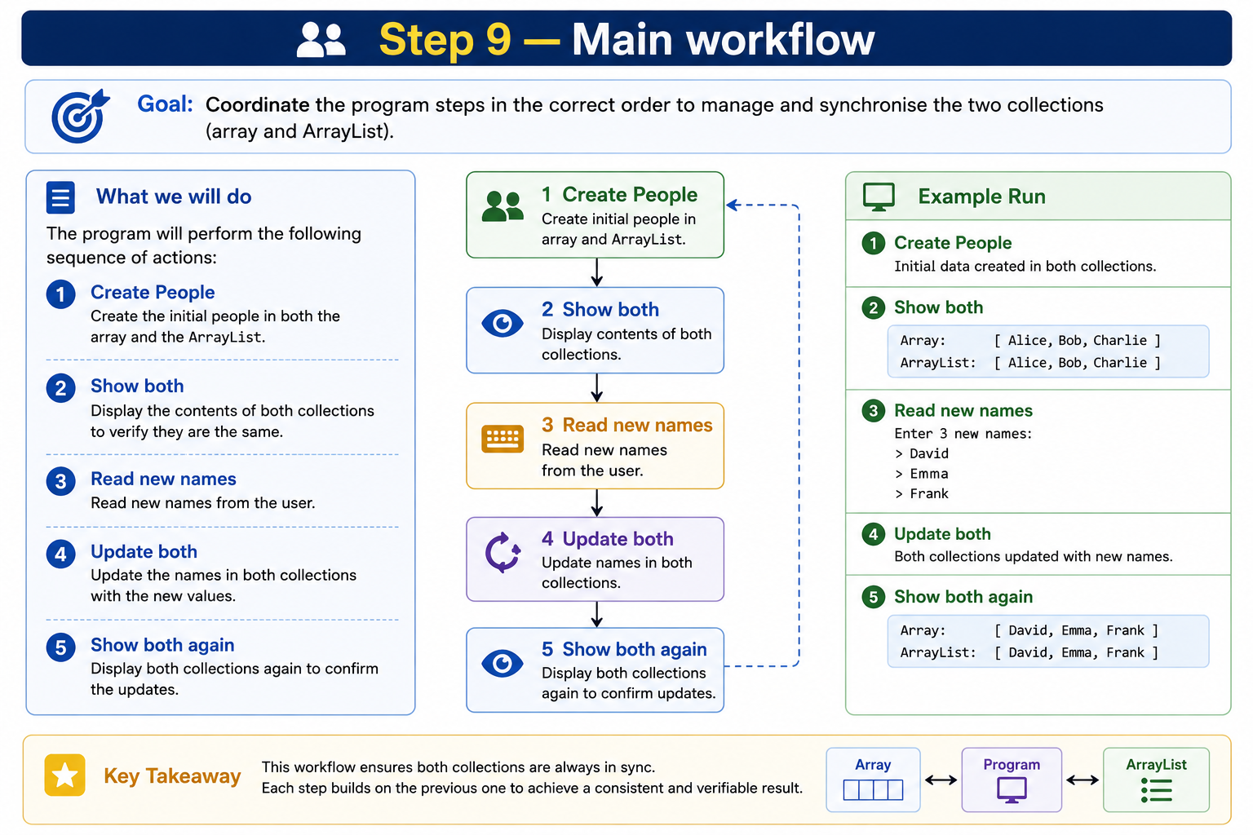

Slide 151
Completed Python — Lab6Exercise1
class Person:
def __init__(
self,
name="Unknown",
age=0):
self.name = name
self.age = age
def get_name(self):
return self.name
def get_age(self):
return self.age
def set_name(
self,
name):
self.name = name
def set_age(
self,
age):
self.age = age
def __str__(self):
return (
f"{self.name} "
f"age is {self.age}"
)
class People:
def __init__(self):
self.person1 = Person()
name = input(
"Enter second person's name: "
)
age = int(
input(
"Enter second person's age: "
)
)

Slide 152
self.person2 = Person(
name,
age
)
def show(
self,
person):
print(person)
def update(
self,
person,
new_name):
person.set_name(
new_name
)
def main():
people = People()
print("\nInitial people:")
people.show(
people.person1
)
people.show(
people.person2
)
new_name1 = input(
"\nNew name for person 1: "
)
new_name2 = input(
"New name for person 2: "
)
people.update(
people.person1,
new_name1
)
people.update(
people.person2,
new_name2
)

Slide 153
print("\nUpdated people:")
people.show(
people.person1
)
people.show(
people.person2
)
if __name__ == "__main__":
main()

Slide 154
Completed Java — Lab6Exercise1
Use two files if preferred:
Person.java
People.java
People.java
import java.util.Scanner;
public class People {
private Person person1;
private Person person2;
public People(
Scanner input) {
person1 =
new Person();
System.out.print(
"Enter second person's name: "
);
String name =
input.nextLine();
System.out.print(
"Enter second person's age: "
);
int age =
input.nextInt();
input.nextLine();
person2 =
new Person(
name,
age
);
}

Slide 155
public void show(
Person person) {
System.out.println(
person
);
}
public void update(
Person person,
String newName) {
person.setName(
newName
);
}
public static void main(
String[] args) {
Scanner input =
new Scanner(System.in);
People people =
new People(input);
System.out.println(
"\nInitial people:"
);
people.show(
people.person1
);
people.show(
people.person2
);
System.out.print(
"\nNew name for person 1: "
);
String newName1 =
input.nextLine();
System.out.print(
"New name for person 2: "
);
String newName2 =
input.nextLine();
people.update(
people.person1,
newName1
);

Slide 156
people.update(
people.person2,
newName2
);
System.out.println(
"\nUpdated people:"
);
people.show(
people.person1
);
people.show(
people.person2
);
input.close();
}
}

Slide 157
Lab 6 Exercises
Develop the program Lab6Exercise2 that contains the following five steps:
Step 1: Develop the following classes: Shop, Product, CashRegister as follows
Product has three fields: type, price and stock
Product has two constructors: The first initializes fields to parameters and the second initializes fields from STDIN
CashRegister has one field: cash
CashRegister has one constructor that initializes the field to default
Shop has two fields: product and cashRegister
Shop has a constructor that initializes the product field using the constructor with parameters and initializes the cashRegister field using the default constructor

Slide 158
Lab 6 Exercises
Step 2: Continue with the Product class
Define a method called ‘isEmpty’ to check the stock level
Define a method called ‘stocked’ that updates the stock level and returns the cash to pay for the stock
Define a method called ‘sold’ that returns the cash earned from a sale and update the stock level
Define a method has(int quantity) that checks if the stock level is higher than the quantity
Define a method cash(quantity) that returns the cash value as a result of a sale
Define a function to return: “<type> level: <stock> at price $<price>”
[price value should be formatted to 2 decimal points]
The function should return: “<type> stock level is: <stock>” if the stock level is zero

Slide 159
Lab 6 Exercises
Step 3: Continue with the CashRegister
Define a method called ‘gain’ that increment the cash level for a sale
Define a method called ‘pay’ that reduces the cash level when restocking
Define a method called ‘isEmpty’ to check the cash level in the register is 0
Define a method has(double cash) that checks if there is enough money to pay when restocking
Define a function to return: “Cash level: $<cash>”
[cash value should be formatted to 2 decimal points]
The function should return: “Cash register is empty” if the cash level is zero

Slide 160
Lab 6 Exercises
Step 4: Continue with the Shop class
Define a method called ‘sell’ that sells a certain quantity of the product.
- Read the quantity to sell from user input
- Check if there is enough stock for the sale, if not, display: “Not enough stock!”
- When the sale occurs, the cash amount gained from the sale should be updated in the cashRegister
Define a method called ‘restock’ enables users to purchase stock of the product.
- Read the quantity to restock from user input
- Check if there is enough cash to make the purchase, if not, display: “Not enough funds!”
- When the restock occurs, the cash amount used for restocking should be deducted from the cashRegister cash level, and he stock level of this product should increase
Define a method called ‘view’ that prints out the fields’ information

Slide 161
Lab 6 Exercises
Step 5: Continue the Shop class
Define a method called ‘menu’ that represents the Shop menu and provide users with 4 choices:
( S ) – sell
( R ) – restock
( V ) – view
( X ) – exit
default → help()
Define a method called ‘help’ that prints out the menu options
Define the main() method should execute the system menu()
NOTE: define the necessary read functions in Shop

Slide 162
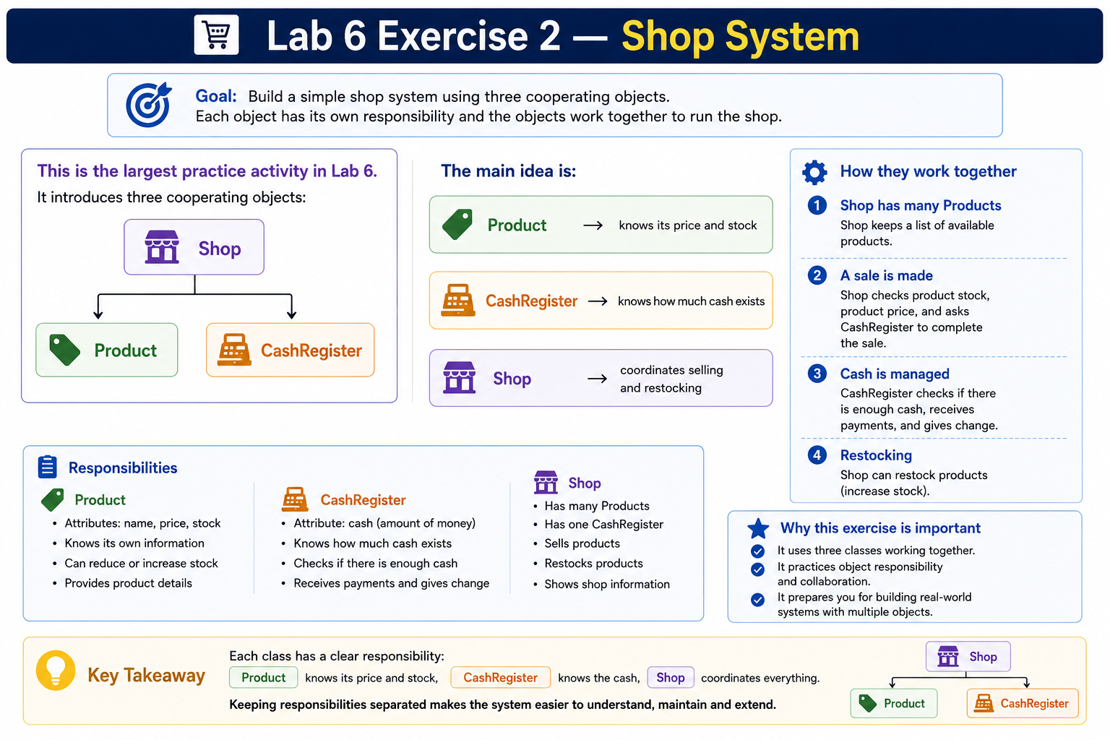

Slide 163
Exercise 2 — Step 1: Product fields
Product needs:
type
price
stock
Python does not provide Java-style constructor overloading. For the second “constructor from STDIN”, a clear Python equivalent is a class method.
Python
class Product:
def __init__(
self,
product_type,
price,
stock):
self.type = product_type
self.price = price
self.stock = stock

Slide 164
@classmethod
def from_input(cls):
product_type = input("Product type: ")
price = float(input("Product price: $"))
stock = int(input("Initial stock: "))
return cls(product_type, price, stock)

Slide 165
Java
First constructor:
public Product(
String type,
double price,
int stock) {
this.type = type;
this.price = price;
this.stock = stock;
}

Slide 166
Second constructor:
public Product(
Scanner input) {
System.out.print(
"Product type: "
);
type = input.nextLine();
System.out.print(
"Product price: $"
);
price = input.nextDouble();
System.out.print(
"Initial stock: "
);
stock = input.nextInt();
input.nextLine();
}

Slide 167
Step 2 — Product isEmpty()
Python
def is_empty(self):
return self.stock == 0
Java
public boolean isEmpty() {
return stock == 0;
}

Slide 168
Step 3 — Product has(quantity)
Python
def has(self, quantity):
return self.stock >= quantity
Java
public boolean has(
int quantity) {
return stock >= quantity;
}

Slide 169
Step 4 — Product cash(quantity)
Cash value of a sale is:
price × quantity
Python
def cash(self, quantity):
return self.price * quantity
Java
public double cash(
int quantity) {
return price * quantity;
}

Slide 170
Step 5 — Product sold()
When an item is sold:
stock decreases
cash earned is returned
Python
def sold(self, quantity):
self.stock -= quantity
return self.cash(quantity)
Java
public double sold(
int quantity) {
stock -= quantity;
return cash(quantity);
}

Slide 171
Step 6 — Product stocked()
Restocking:
stock increases
cost is returned
We assume the restocking cost uses the same product price because the task does not specify a separate wholesale cost.
Python
def stocked(self, quantity):
cost = self.cash(quantity)
self.stock += quantity
return cost
Java
public double stocked(
int quantity) {
double cost =
cash(quantity);
stock += quantity;
return cost;
}

Slide 172
Step 7 — Product information
If stock is zero:
Milk stock level is: 0
Otherwise:
Milk level: 10 at price $2.50
Python
def __str__(self):
if self.is_empty():
return (f"{self.type} "f"stock level is: "f"{self.stock}")
return (f"{self.type} level: "f"{self.stock} "f"at price "f"${self.price:.2f}")

Slide 173
Java
@Override
public String toString() {
if (isEmpty()) {
return type
+ " stock level is: "
+ stock;
}
return String.format(
"%s level: %d at price $%.2f",
type,
stock,
price
);
}

Slide 174
Completed Product — Python
class Product:
def __init__(
self,
product_type,
price,
stock):
self.type = product_type
self.price = price
self.stock = stock
@classmethod
def from_input(cls):
product_type = input(
"Product type: "
)
price = float(
input(
"Product price: $"
)
)
stock = int(
input(
"Initial stock: "
)
)
return cls(
product_type,
price,
stock
)
def is_empty(self):
return self.stock == 0
def has(
self,
quantity):

Slide 175
return self.stock >= quantity
def cash(
self,
quantity):
return (
self.price
* quantity
)
def sold(
self,
quantity):
self.stock -= quantity
return self.cash(
quantity
)
def stocked(
self,
quantity):
cost = self.cash(
quantity
)
self.stock += quantity
return cost
def __str__(self):
if self.is_empty():
return (
f"{self.type} "
f"stock level is: "
f"{self.stock}"
)
return (
f"{self.type} level: "
f"{self.stock} "
f"at price "
f"${self.price:.2f}"
)

Slide 176
CashRegister Class
It has one field:
cash
Default value is not specified, so I use:
0.0
Step 8 — Constructor
Python
class CashRegister:
def __init__(self):
self.cash = 0.0
Java
public CashRegister() {
cash = 0.0;
}

Slide 177
Step 9 — gain()
Money from a sale enters the cash register.
Python
def gain(self, amount):
self.cash += amount
Java
public void gain(
double amount) {
cash += amount;
}

Slide 178
Step 10 — pay()
Restocking reduces cash.
Python
def pay(self, amount):
self.cash -= amount
Java
public void pay(
double amount) {
cash -= amount;
}

Slide 179
Step 11 — isEmpty()
Python
def is_empty(self):
return self.cash == 0
Java
public boolean isEmpty() {
return cash == 0;
}

Slide 180
Step 12 — has(cash)
Python
def has(self, amount):
return self.cash >= amount
Java
public boolean has(
double amount) {
return cash >= amount;
}

Slide 181
Completed CashRegister — Python
class CashRegister:
def __init__(self):
self.cash = 0.0
def gain(
self,
amount):
self.cash += amount
def pay(
self,
amount):
self.cash -= amount
def is_empty(self):
return self.cash == 0
def has(
self,
amount):
return self.cash >= amount
def __str__(self):
if self.is_empty():
return (
"Cash register is empty"
)
return (
f"Cash level: "
f"${self.cash:.2f}"
)

Slide 182
Shop Class
Shop has:
product
cashRegister
The Shop coordinates their interactions.
Step 14 — Shop constructor
Python
class Shop:
def __init__(
self,
product_type,
price,
stock):
self.product = Product(product_type, price, stock)
self.cash_register = (CashRegister())

Slide 183
Java
public Shop(
String type,
double price,
int stock) {
product =
new Product(
type,
price,
stock
);
cashRegister =
new CashRegister();
}

Slide 184
Step 15 — read quantity helper
Python
def read_quantity(self, message):
return int(input(message))
Java
private int readQuantity(
Scanner input,
String message) {
System.out.print(message);
return input.nextInt();
}

Slide 185
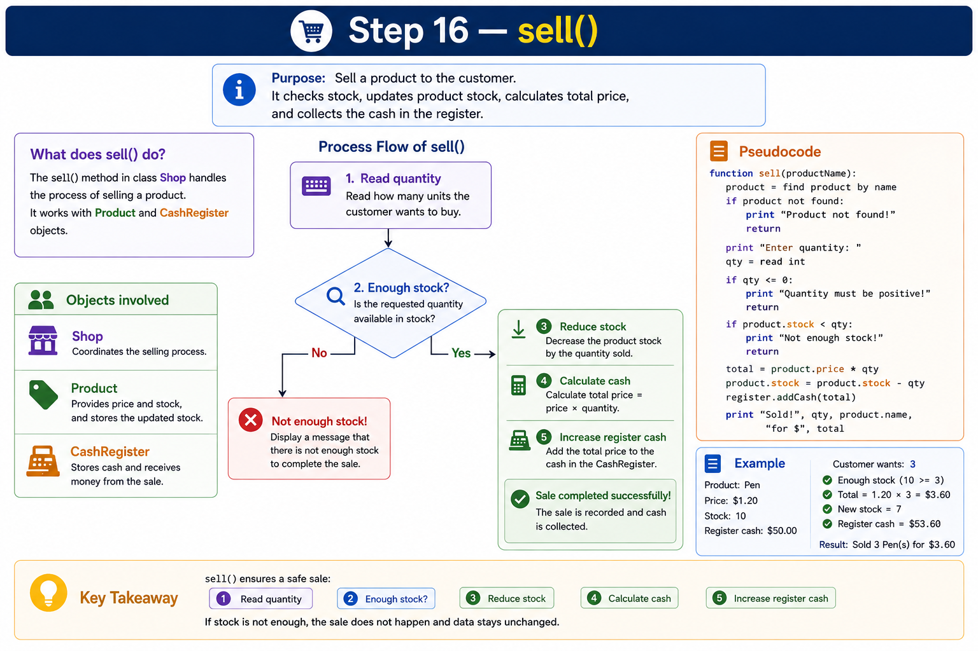
Python
def sell(self):
quantity = self.read_quantity("Quantity to sell: ")
if not self.product.has(quantity):
print("Not enough stock!")
return
earned = self.product.sold(quantity)
self.cash_register.gain(earned)

Slide 186
Java
public void sell(
Scanner input) {
int quantity =
readQuantity(
input,
"Quantity to sell: "
);
if (!product.has(quantity)) {
System.out.println(
"Not enough stock!"
);
return;
}
double earned =
product.sold(quantity);
cashRegister.gain(
earned
);
}

Slide 187
Python
def restock(self):
quantity = self.read_quantity(
"Quantity to restock: "
)
cost = self.product.cash(
quantity
)
if not self.cash_register.has(
cost):
print(
"Not enough funds!"
)
return
self.cash_register.pay(
cost
)
self.product.stocked(
quantity
)
Java
public void restock(
Scanner input) {
int quantity =
readQuantity(
input,
"Quantity to restock: "
);
double cost =
product.cash(quantity);
if (!cashRegister.has(cost)) {
System.out.println(
"Not enough funds!"
);
return;
}
cashRegister.pay(cost);
product.stocked(quantity);
}

Slide 188
Step 18 — view()
Python
def view(self):
print(self.product)
print(self.cash_register)
Java
public void view() {
System.out.println(
product
);
System.out.println(
cashRegister
);
}

Slide 189
Step 19 — help()
Python
def help(self):
print("Shop menu")
print("S = sell")
print("R = restock")
print("V = view")
print("X = exit")
Java
public void help() {
System.out.println(
"Shop menu"
);
System.out.println(
"S = sell"
);
System.out.println(
"R = restock"
);
System.out.println(
"V = view"
);
System.out.println(
"X = exit"
);
}

Slide 190
Java
public void menu(
Scanner input) {
while (true) {
System.out.print(
"Shop menu "
+ "(S/R/V/X): "
);
String choice =
input.nextLine()
.toUpperCase();
switch (choice) {
case "S":
sell(input);
input.nextLine();
break;
case "R":
restock(input);
input.nextLine();
break;
case "V":
view();
break;
case "X":
return;
default:
help();
}
}
}
Step 20 — menu()
Python
def menu(self):
while True:
choice = input(
"Shop menu "
"(S/R/V/X): "
).upper()
if choice == "S":
self.sell()
elif choice == "R":
self.restock()
elif choice == "V":
self.view()
elif choice == "X":
break
else:
self.help()

Slide 191
Completed Python — Lab6Exercise2
class Product:
def __init__(
self,
product_type,
price,
stock):
self.type = product_type
self.price = price
self.stock = stock
@classmethod
def from_input(cls):
product_type = input(
"Product type: "
)
price = float(
input(
"Product price: $"
)
)
stock = int(
input(
"Initial stock: "
)
)
return cls(
product_type,
price,
stock
)
def is_empty(self):
return self.stock == 0
def has(
self,
quantity):
return self.stock >= quantity
def cash(
self,
quantity):
return (
self.price
* quantity
)
def sold(
self,
quantity):
self.stock -= quantity
return self.cash(
quantity
)
def stocked(
self,
quantity):
cost = self.cash(
quantity
)
self.stock += quantity
return cost
def __str__(self):
if self.is_empty():
return (
f"{self.type} "
f"stock level is: "
f"{self.stock}"
)
return (
f"{self.type} level: "
f"{self.stock} "
f"at price "
f"${self.price:.2f}"
)
class CashRegister:
def __init__(self):
self.cash = 0.0
def gain(
self,
amount):
self.cash += amount
def pay(
self,
amount):
self.cash -= amount
def is_empty(self):
return self.cash == 0
def has(
self,
amount):
return self.cash >= amount
def __str__(self):
if self.is_empty():
return (
"Cash register is empty"
)
return (
f"Cash level: "
f"${self.cash:.2f}"
)
class Shop:
def __init__(
self,
product_type,
price,
stock):
self.product = Product(
product_type,
price,
stock
)
self.cash_register = (
CashRegister()
)
def read_quantity(
self,
message):
return int(
input(message)
)
def sell(self):
quantity = self.read_quantity(
"Quantity to sell: "
)
if not self.product.has(
quantity):
print(
"Not enough stock!"
)
return
earned = self.product.sold(
quantity
)
self.cash_register.gain(
earned
)
def restock(self):
quantity = self.read_quantity(
"Quantity to restock: "
)
cost = self.product.cash(
quantity
)
if not self.cash_register.has(
cost):
print(
"Not enough funds!"
)
return
self.cash_register.pay(
cost
)
self.product.stocked(
quantity
)
def view(self):
print(self.product)
print(
self.cash_register
)
def help(self):
print("Shop menu")
print("S = sell")
print("R = restock")
print("V = view")
print("X = exit")
def menu(self):
while True:
choice = input(
"Shop menu "
"(S/R/V/X): "
).upper()
if choice == "S":
self.sell()
elif choice == "R":
self.restock()
elif choice == "V":
self.view()
elif choice == "X":
break
else:
self.help()
def main():
product_type = input(
"Product type: "
)
price = float(
input(
"Product price: $"
)
)
stock = int(
input(
"Initial stock: "
)
)
shop = Shop(
product_type,
price,
stock
)
shop.menu()
if __name__ == "__main__":
main()

Slide 192
Completed Java — Lab6Exercise2
Three files:
Product.java
CashRegister.java
Shop.java
Product.java
import java.util.Scanner;
public class Product {
private String type;
private double price;
private int stock;
public Product(
String type,
double price,
int stock) {
this.type = type;
this.price = price;
this.stock = stock;
}
public Product(
Scanner input) {
System.out.print(
"Product type: "
);
type =
input.nextLine();
System.out.print(
"Product price: $"
);
price =
input.nextDouble();
System.out.print(
"Initial stock: "
);
stock =
input.nextInt();
input.nextLine();
}
public boolean isEmpty() {
return stock == 0;
}
public boolean has(
int quantity) {
return stock >= quantity;
}
public double cash(
int quantity) {
return price * quantity;
}
public double sold(
int quantity) {
stock -= quantity;
return cash(quantity);
}
public double stocked(
int quantity) {
double cost =
cash(quantity);
stock += quantity;
return cost;
}
@Override
public String toString() {
if (isEmpty()) {
return type
+ " stock level is: "
+ stock;
}
return String.format(
"%s level: %d at price $%.2f",
type,
stock,
price
);
}
}
CashRegister.java
public class CashRegister {
private double cash;
public CashRegister() {
cash = 0.0;
}
public void gain(
double amount) {
cash += amount;
}
public void pay(
double amount) {
cash -= amount;
}
public boolean isEmpty() {
return cash == 0;
}
public boolean has(
double amount) {
return cash >= amount;
}
@Override
public String toString() {
if (isEmpty()) {
return (
"Cash register is empty"
);
}
return String.format(
"Cash level: $%.2f",
cash
);
}
}
Shop.java
import java.util.Scanner;
public class Shop {
private Product product;
private CashRegister cashRegister;
public Shop(
String type,
double price,
int stock) {
product =
new Product(
type,
price,
stock
);
cashRegister =
new CashRegister();
}
private int readQuantity(
Scanner input,
String message) {
System.out.print(message);
return input.nextInt();
}
public void sell(
Scanner input) {
int quantity =
readQuantity(
input,
"Quantity to sell: "
);
if (!product.has(quantity)) {
System.out.println(
"Not enough stock!"
);
return;
}
double earned =
product.sold(
quantity
);
cashRegister.gain(
earned
);
}
public void restock(
Scanner input) {
int quantity =
readQuantity(
input,
"Quantity to restock: "
);
double cost =
product.cash(
quantity
);
if (!cashRegister.has(cost)) {
System.out.println(
"Not enough funds!"
);
return;
}
cashRegister.pay(
cost
);
product.stocked(
quantity
);
}
public void view() {
System.out.println(
product
);
System.out.println(
cashRegister
);
}
public void help() {
System.out.println(
"Shop menu"
);
System.out.println(
"S = sell"
);
System.out.println(
"R = restock"
);
System.out.println(
"V = view"
);
System.out.println(
"X = exit"
);
}
public void menu(
Scanner input) {
while (true) {
System.out.print(
"Shop menu "
+ "(S/R/V/X): "
);
String choice =
input.nextLine()
.toUpperCase();
switch (choice) {
case "S":
sell(input);
input.nextLine();
break;
case "R":
restock(input);
input.nextLine();
break;
case "V":
view();
break;
case "X":
return;
default:
help();
}
}
}
public static void main(
String[] args) {
Scanner input =
new Scanner(System.in);
System.out.print(
"Product type: "
);
String type =
input.nextLine();
System.out.print(
"Product price: $"
);
double price =
input.nextDouble();
System.out.print(
"Initial stock: "
);
int stock =
input.nextInt();
input.nextLine();
Shop shop =
new Shop(
type,
price,
stock
);
shop.menu(input);
input.close();
}
}

Slide 193

Happy Learning and Bright Futures Ahead! Dr. Farshid Keivanian Stay Connected: linkedin.com/in/farshid-keivanian github.com/FarshidKeivanian
Education is the most powerful weapon you can use to change the world. — Nelson Mandela

